Slide 1




















PLATINUM
GOLD
SILVER
SPONSORS
EVENT PARTNERS

Slide 2
Admin Bouncers: How Endpoint Privilege Management Keeps Your Local Admin Party Exclusive!
Jens Du Four
Notes:
Workplace Ninjas UK assumes you have sought appropriate permission to use the content in your presentation. It is your responsibility to ensure you are not breaking NDAs or infringing on copyright notices.

Slide 3





Jens Du Four
Cloud Endpoint Technical Specialist @ Microsoft BeLux
Teacher @ CodeFever
Crew Member @ MC2MC
Microsoft Certified Trainer
https://www.facebook.com/dufour.jens
https://www.instagram.com/jens.dufour/
https://www.linkedin.com/in/jensdufour/
https://jensdufour.be/
Notes:
Use this to add speaker bio

Slide 4

The elephant in the room
Intune Suite
Add to Plan 1 to utilize these solutions*
Remote Help
Endpoint Privilege Management
Advanced Analytics
Enterprise Application Management
Cloud PKI
All Intune Plan 2 features
Prerequisite
Intune Plan 1
Intune Plan 1
Included in EMS E3 or Microsoft 365 E3, ME5, F1, F3, and Business Premium plans
Cross-platform endpoint management
Endpoint security built in
Endpoint analytics
App protection policies
Shared device management
Device compliance
Risk and app based conditional access
Proactive remediation
Integrated Microsoft 365 and security
Intune Plan 2
Add to Plan 1 to utilize these features
Tunnel for Mobile App Management
Mobile firmware update management
Specialty device management
Multiple managed accounts (future)
Prerequisite
Intune Plan 1
*Also available as individual add-ons
aka.ms/IntuneSuitePricing

Slide 5

What is the problem?
Running as a standard user reduces the attack surface…
Zero Trust Framework
Least Privilege Access
Impact on user productivity…
Standard users can’t do everything

Slide 6
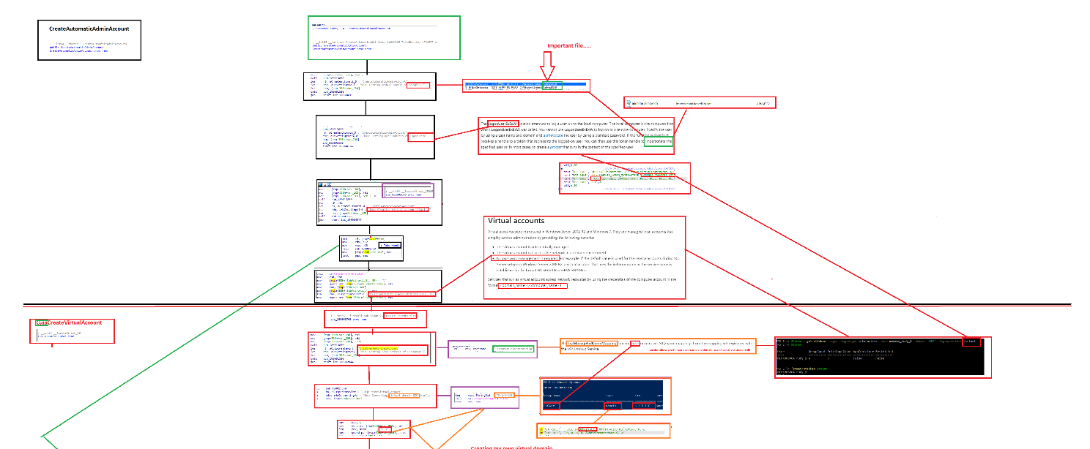
How does it work?
Source: Ooms, R. (2023, May 31). The Virtual Account that rocks the EPM! Call4Cloud from https://call4cloud.nl/virtual-account-epm-elevation/

Slide 7
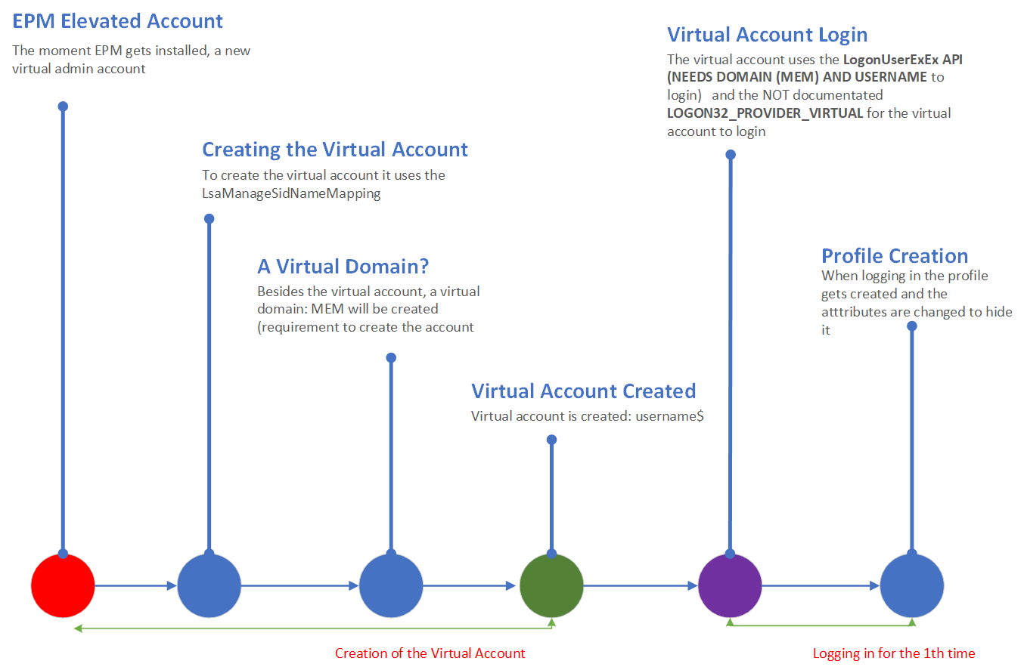
How does it work?
Source: Ooms, R. (2023, May 31). The Virtual Account that rocks the EPM! Call4Cloud from https://call4cloud.nl/virtual-account-epm-elevation/

Slide 8
Getting started with EPM!
Get a license
Deploy an “elevation settings policy”
Deploy “elevation rules policy”
Notes:
Learn about using Endpoint Privilege Management with Microsoft Intune | Microsoft Learn

Slide 9
Getting started with EPM!
Get a license
Deploy an “elevation settings policy”
Deploy “elevation rules policy”
Notes:
Learn about using Endpoint Privilege Management with Microsoft Intune | Microsoft Learn

Slide 10
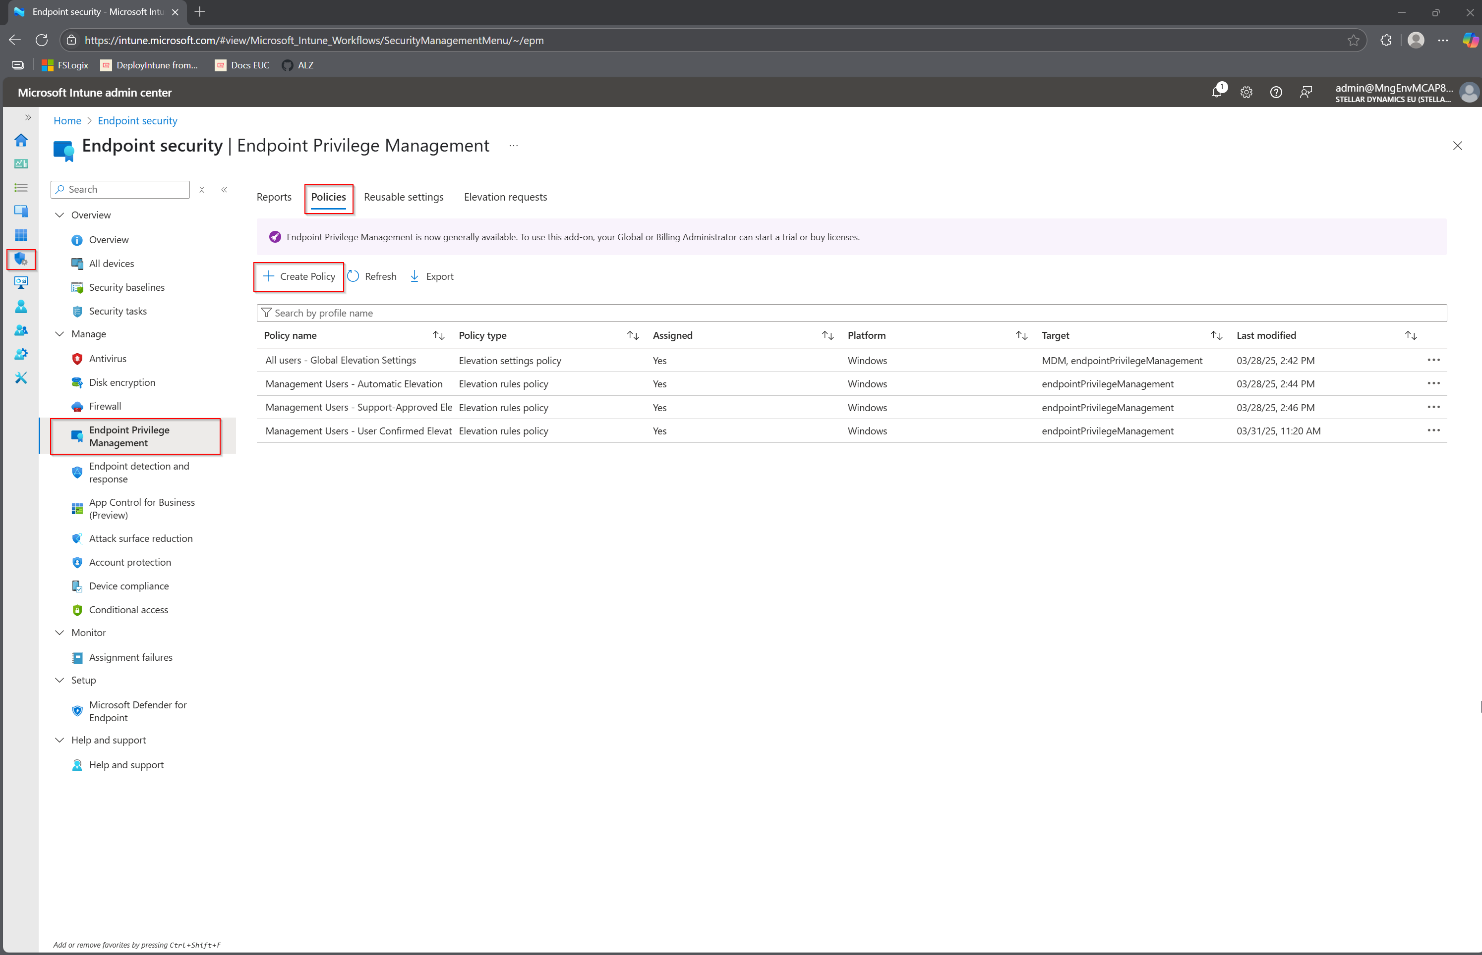
Deploy an Elevation Settings Policy
Notes:
Elevation Settings Policy

Slide 11
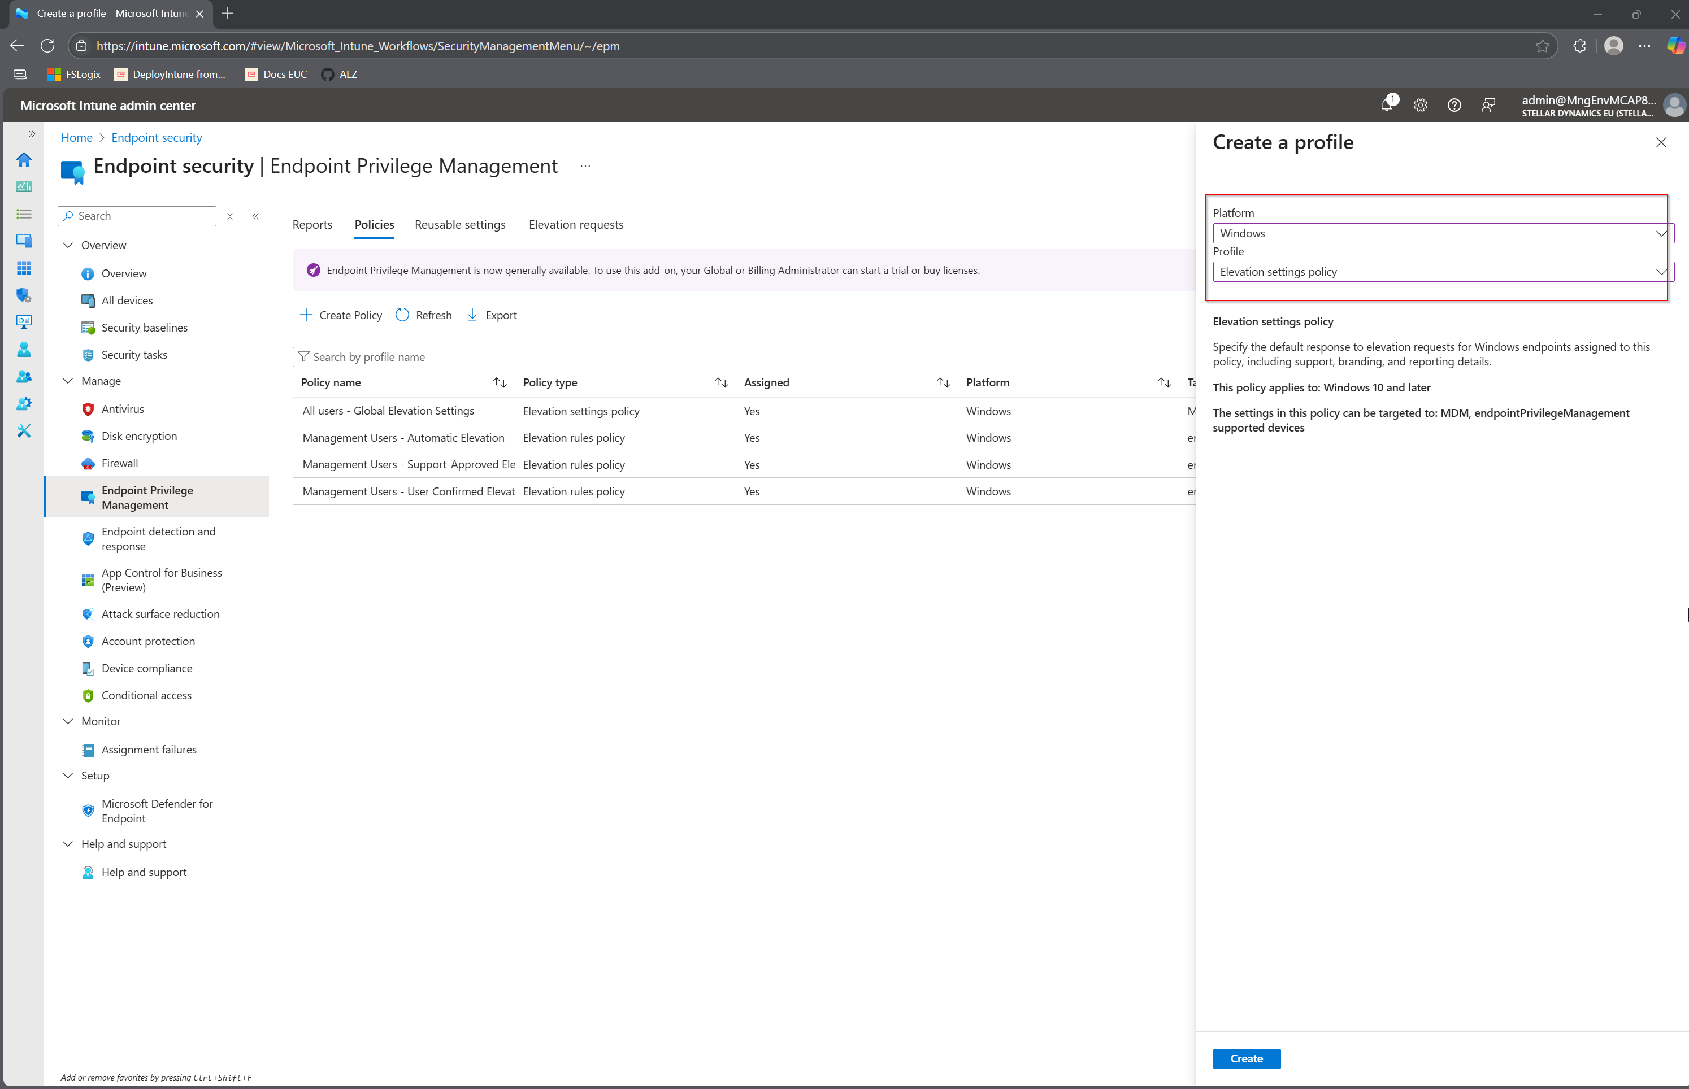

Slide 12
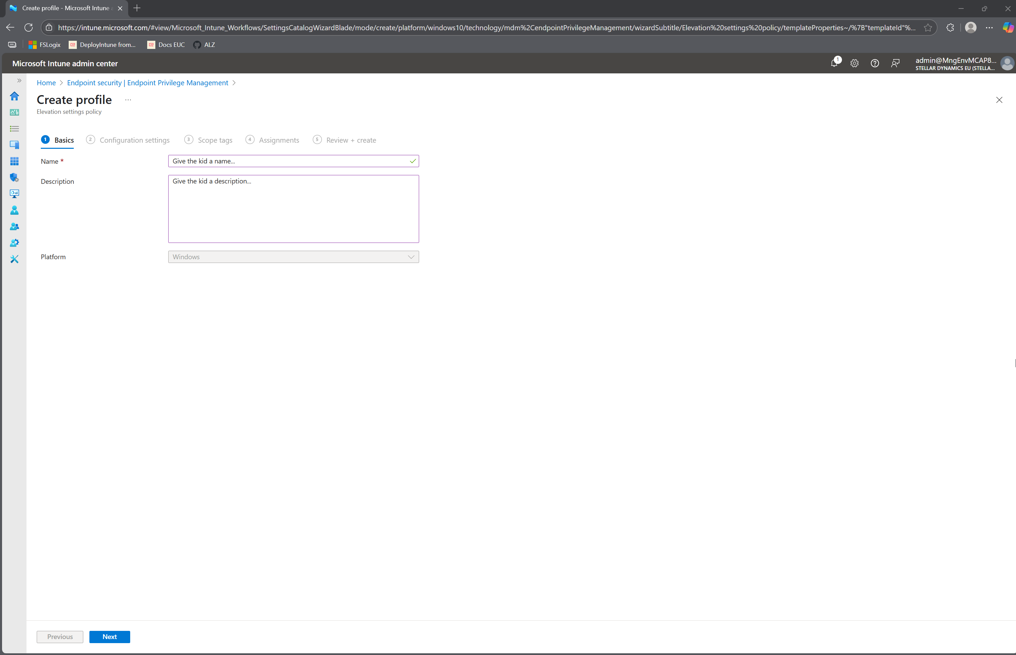

Slide 13
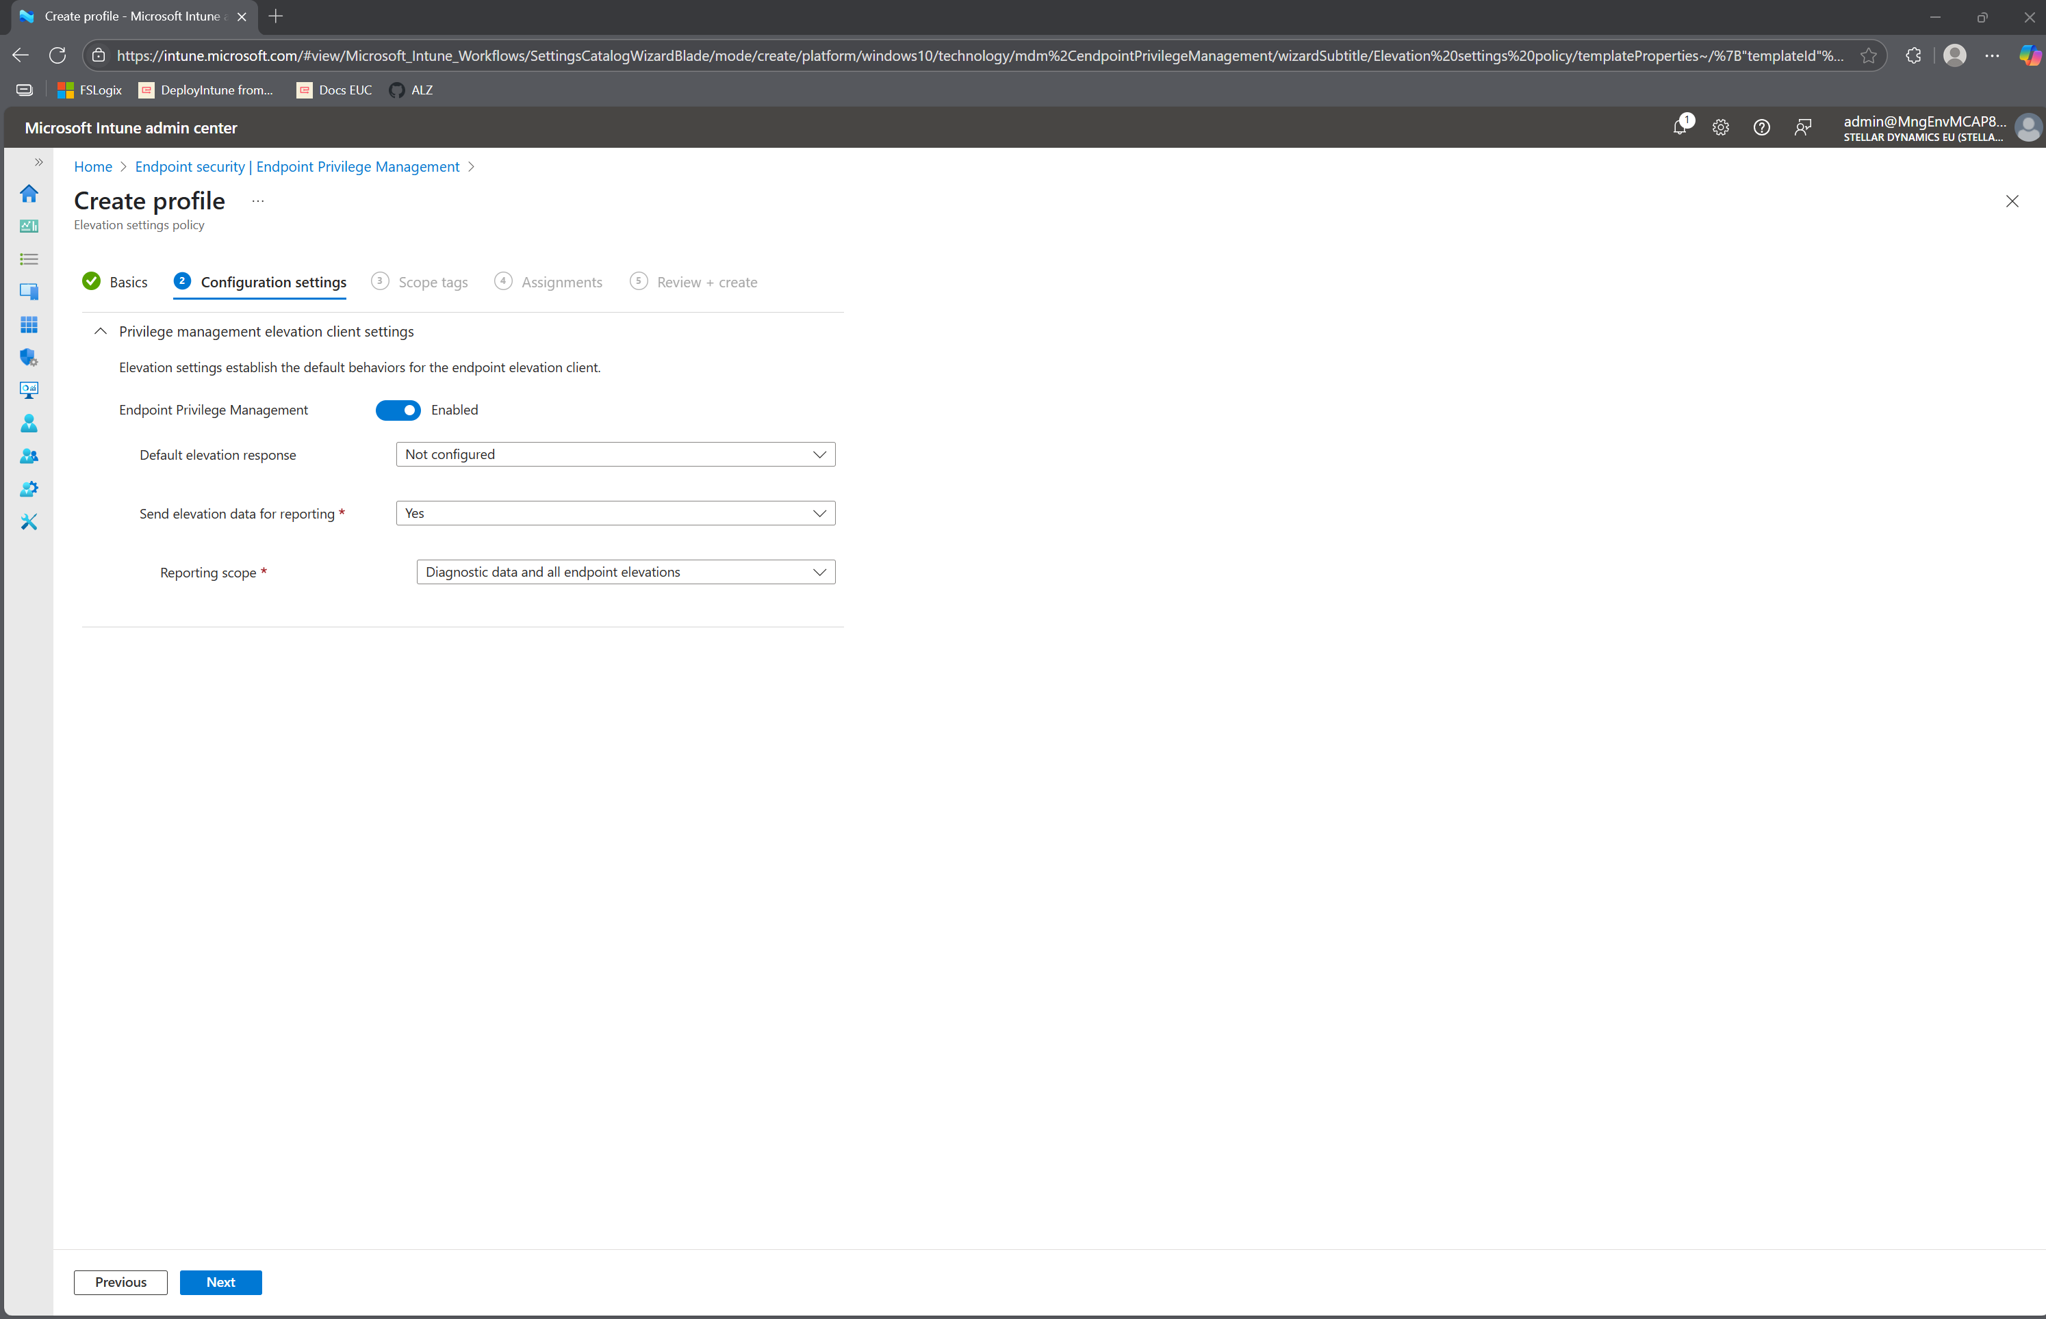

Slide 14
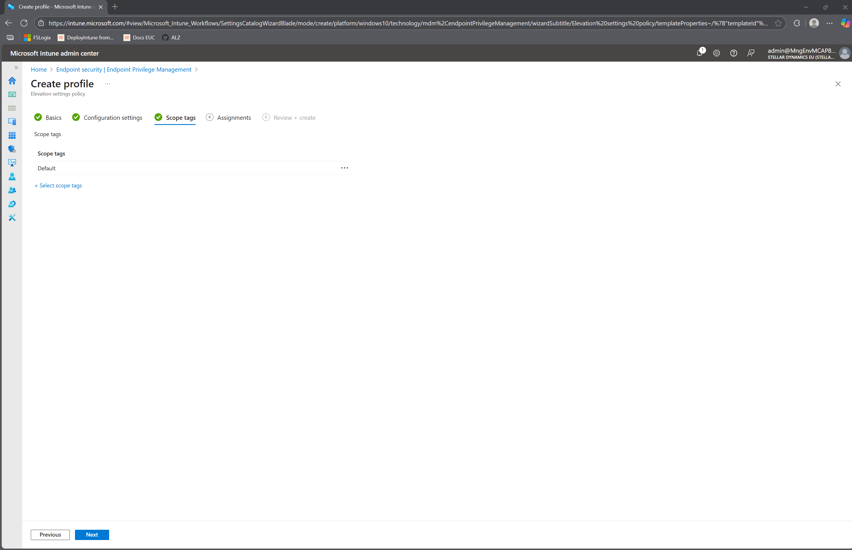

Slide 15
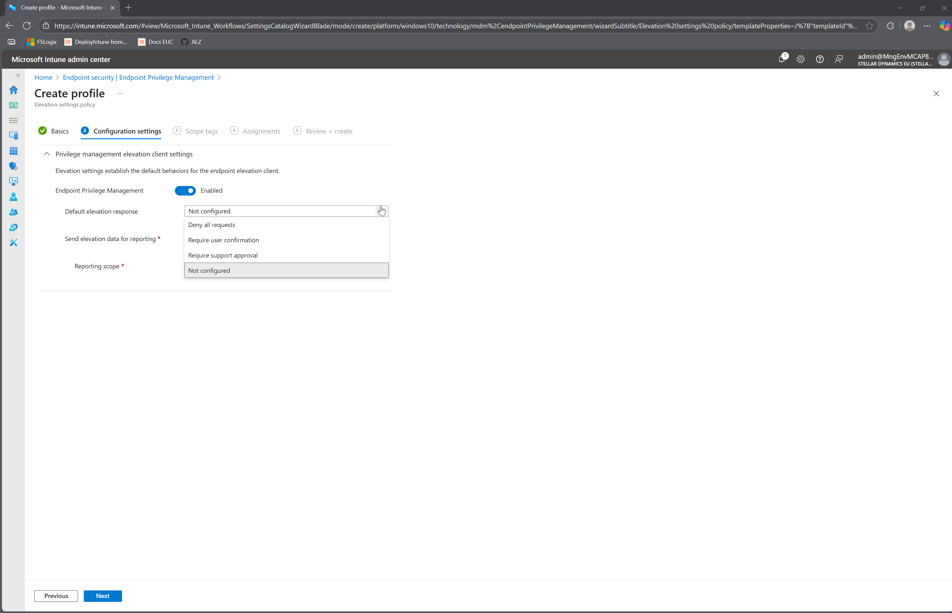

Slide 16
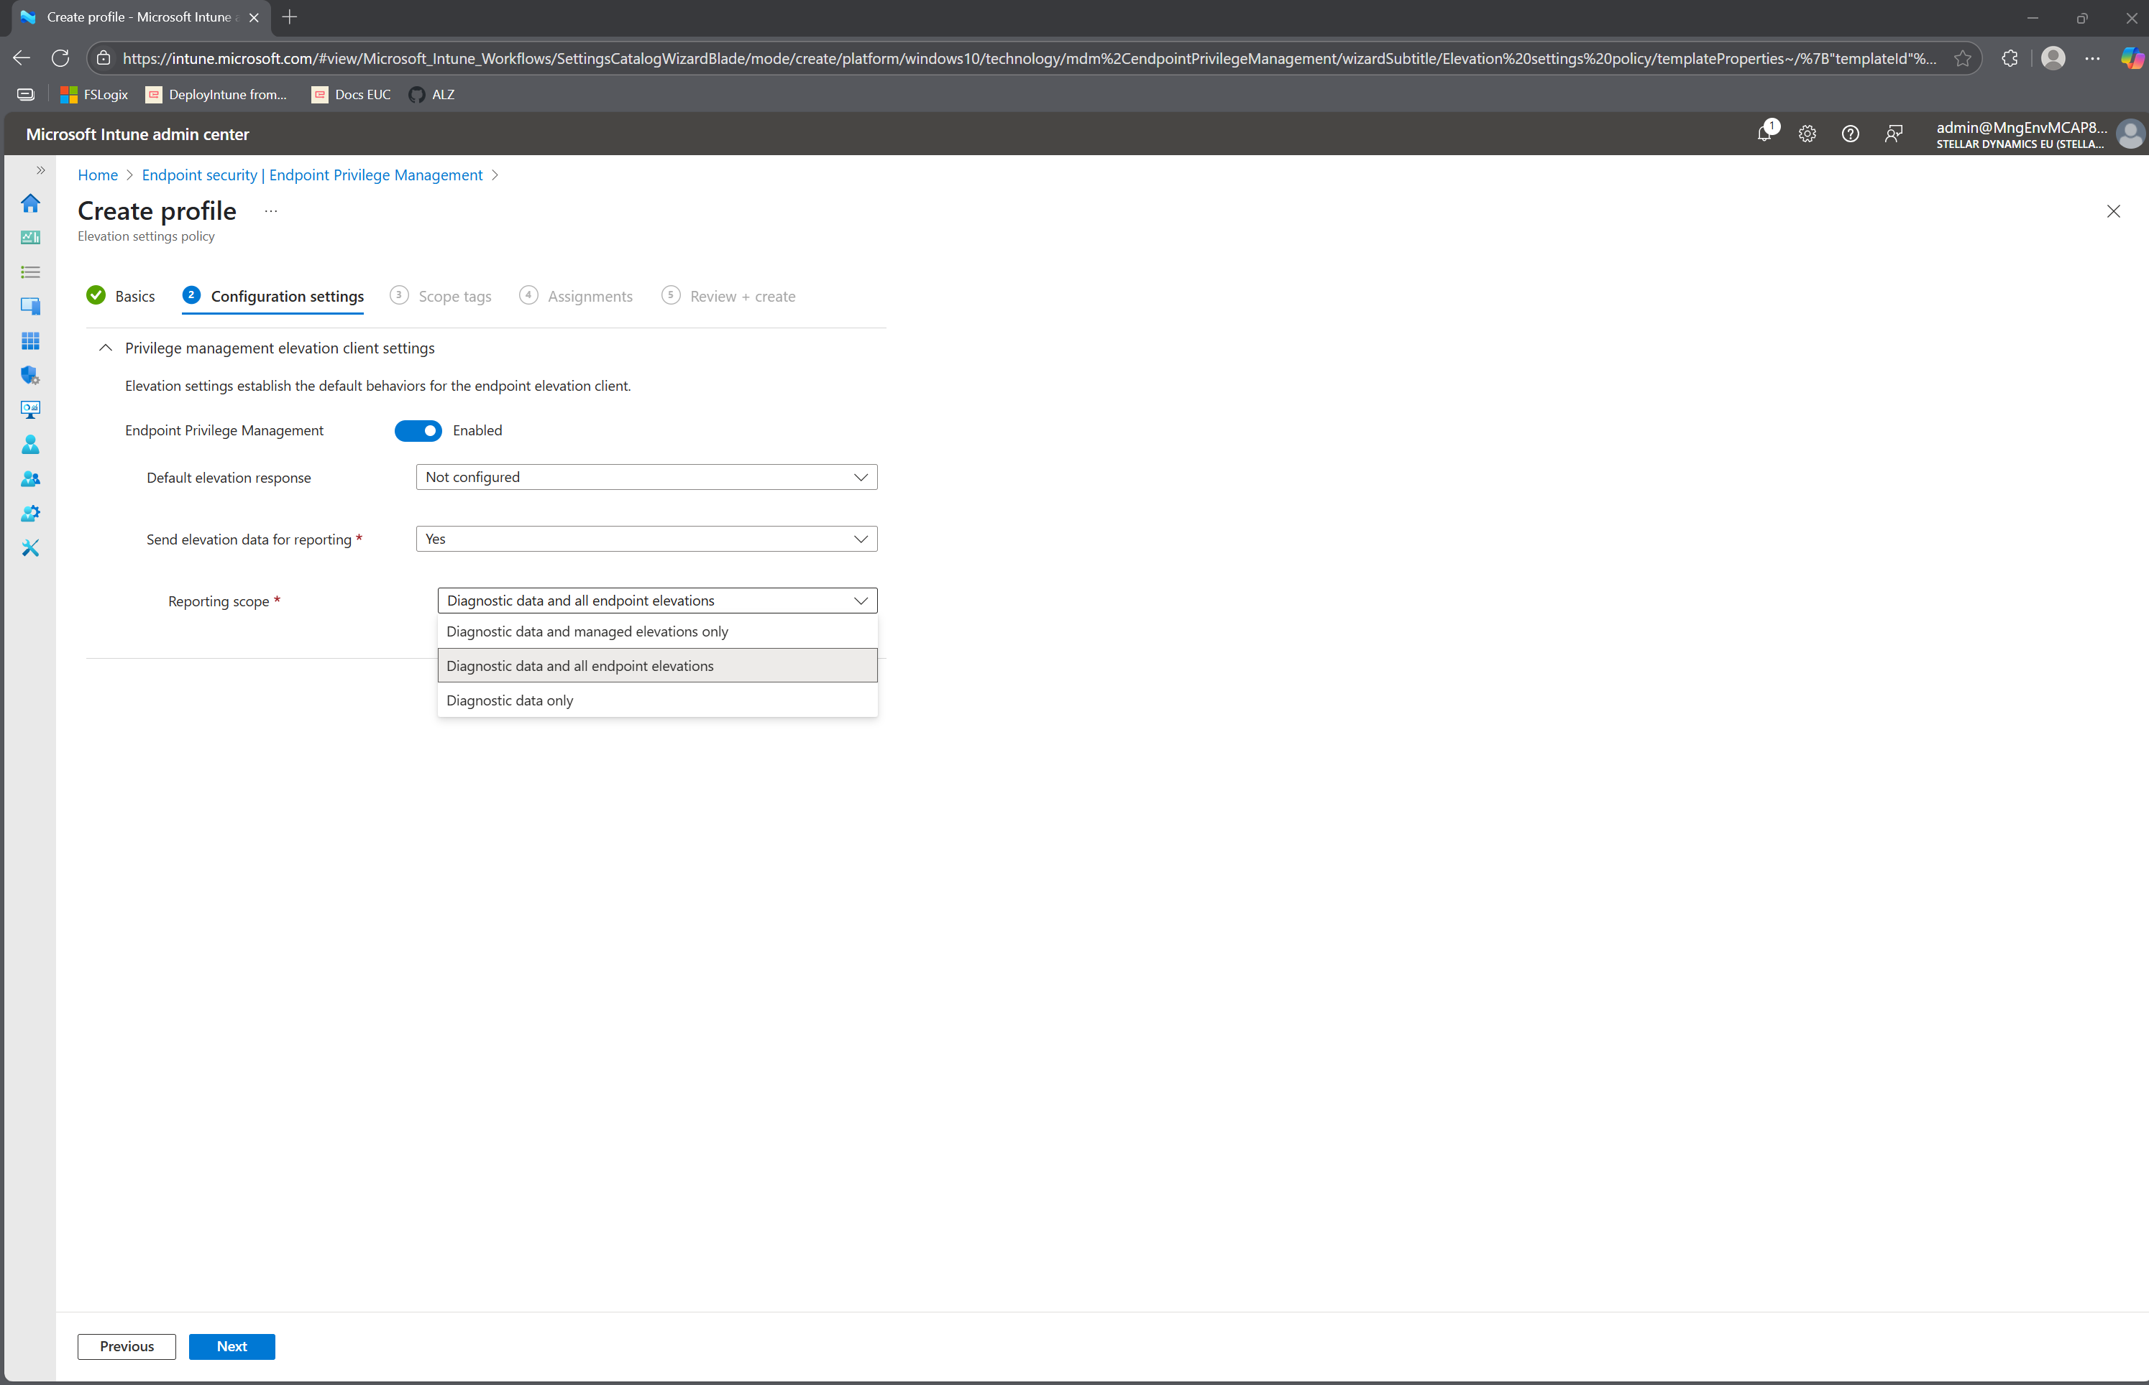

Slide 17
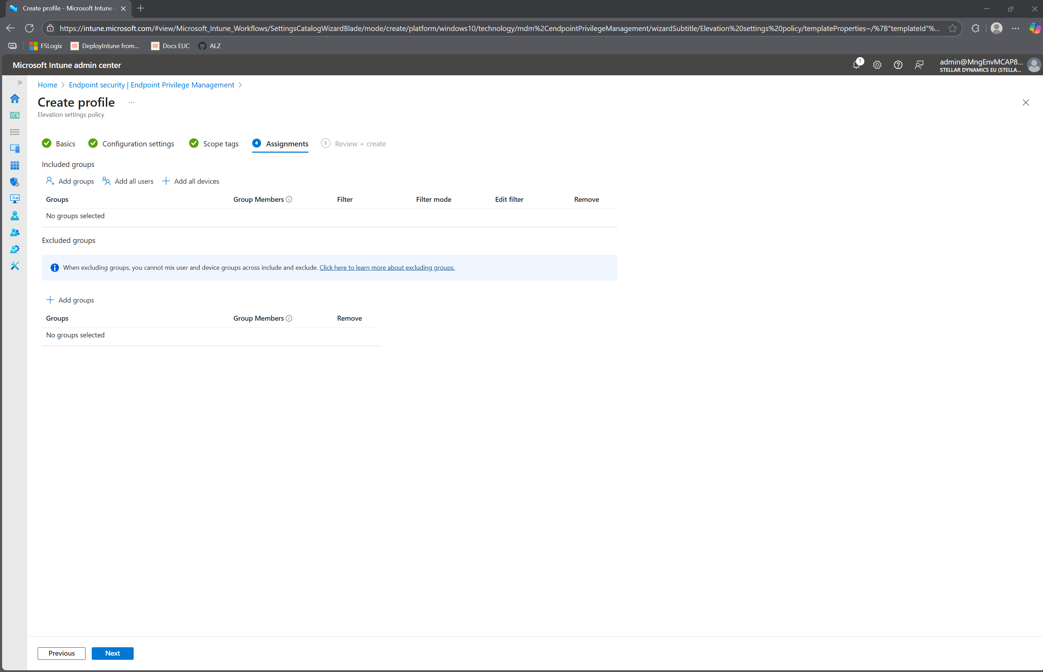

Slide 18
Getting started with EPM!
Get a license
Deploy an “elevation settings policy”
Deploy “elevation rules policy”
Notes:
Learn about using Endpoint Privilege Management with Microsoft Intune | Microsoft Learn

Slide 19
What types of Elevation Rules Policies are there?
Automatic Elevation
User Confirmed Elevation
Support Approved Elevation
Provides an audit trail
Opaque to the end-user
Provides an audit trail
Offers additional controls
Create a “guest list” of what can be elevated first
Confronts the user with a check
Provides an audit trail
Allows you to add elevation to the “guest list”
Confronts the user with a check
Notes:
0,55 tussen 3 kolommen

Slide 20
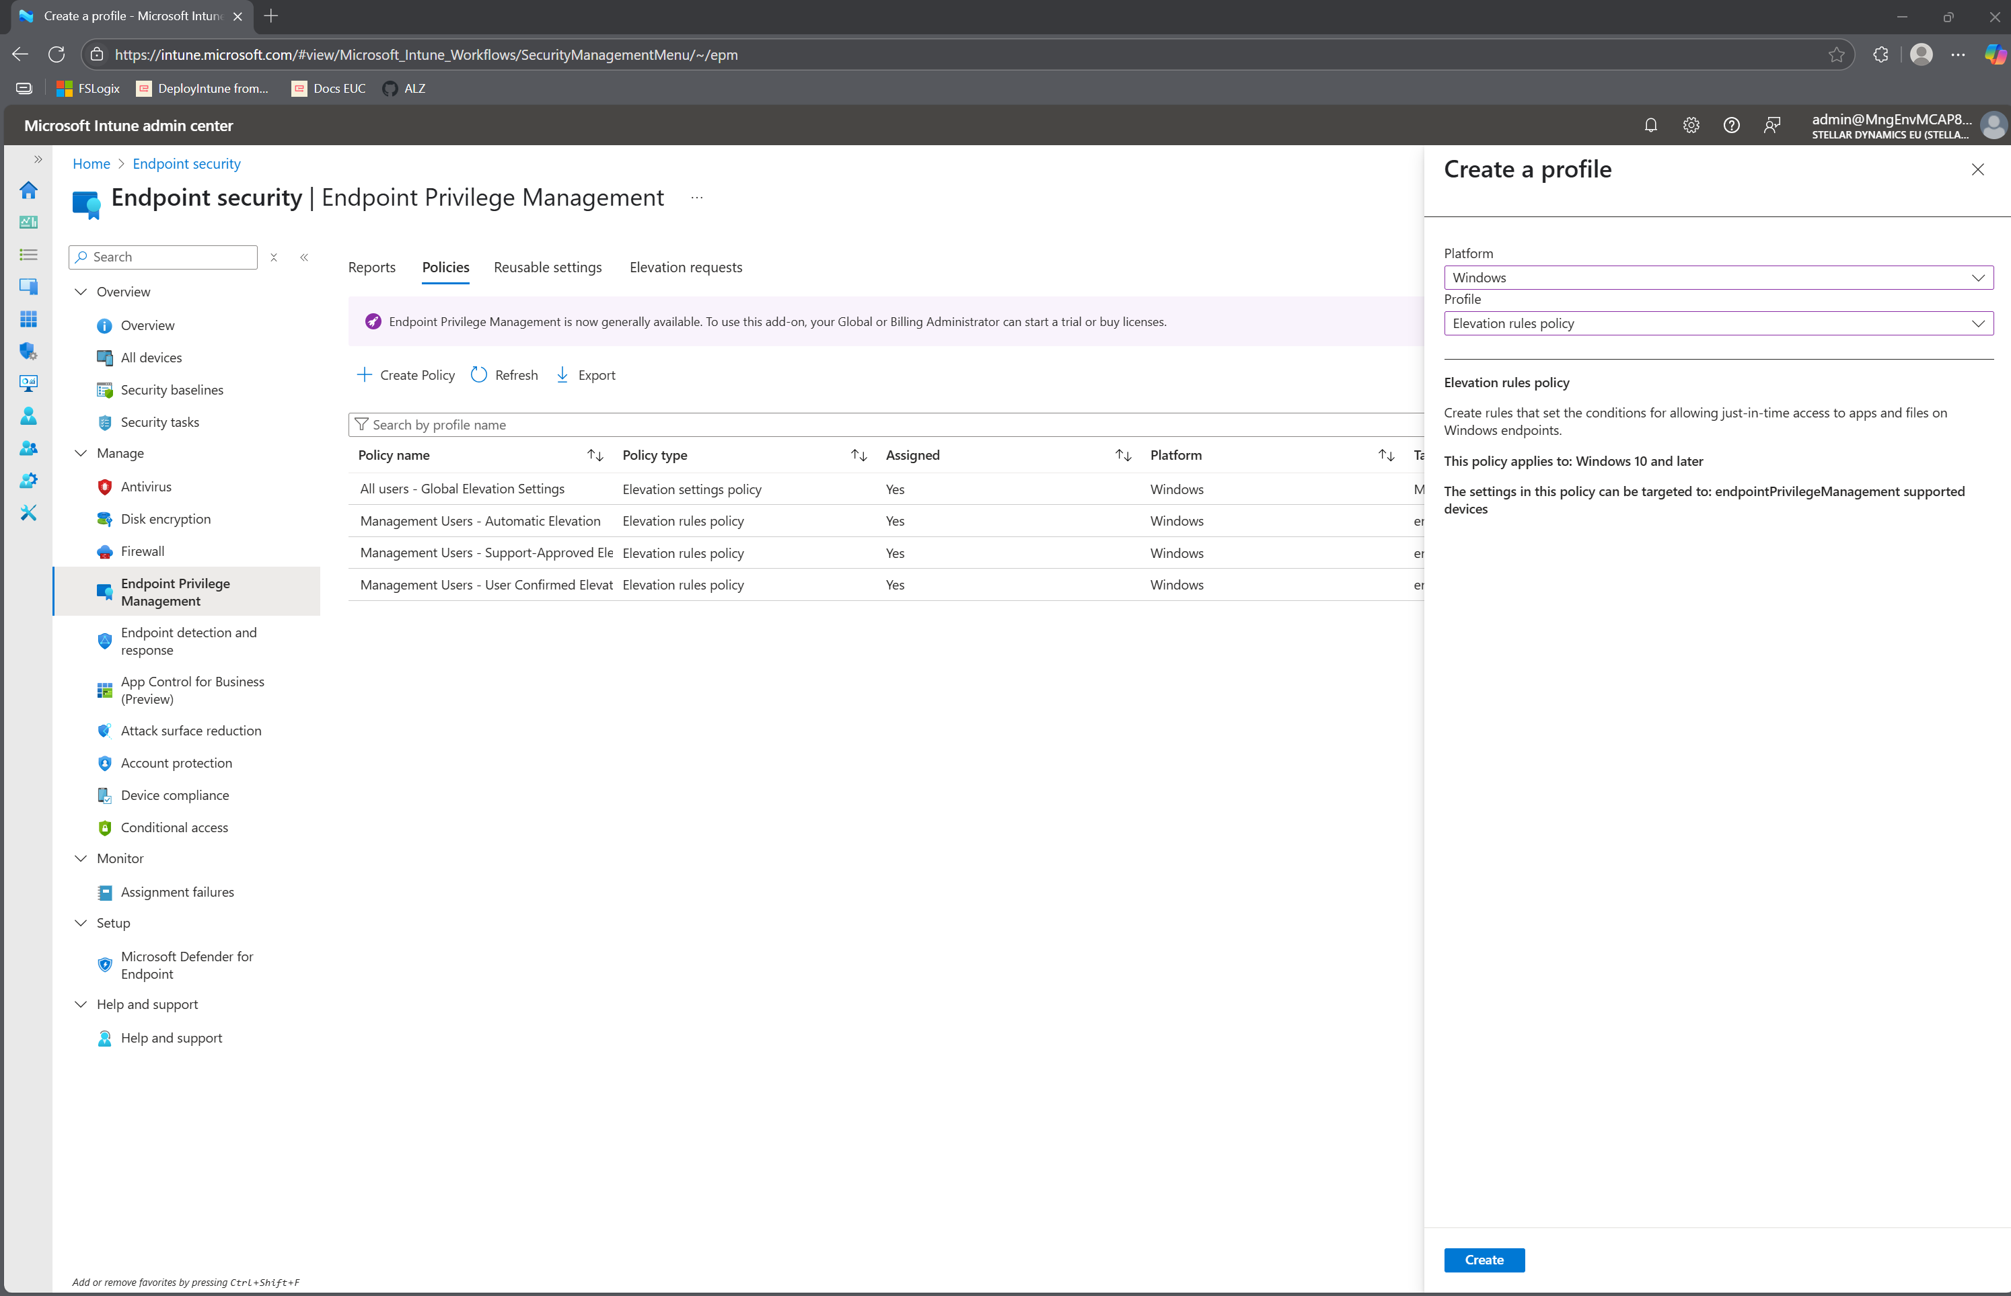
Notes:
Elevation Rules Policy

Slide 21
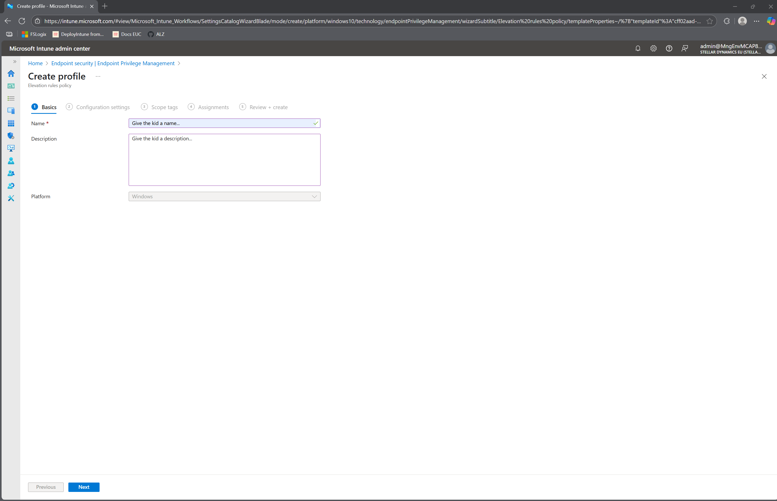

Slide 22
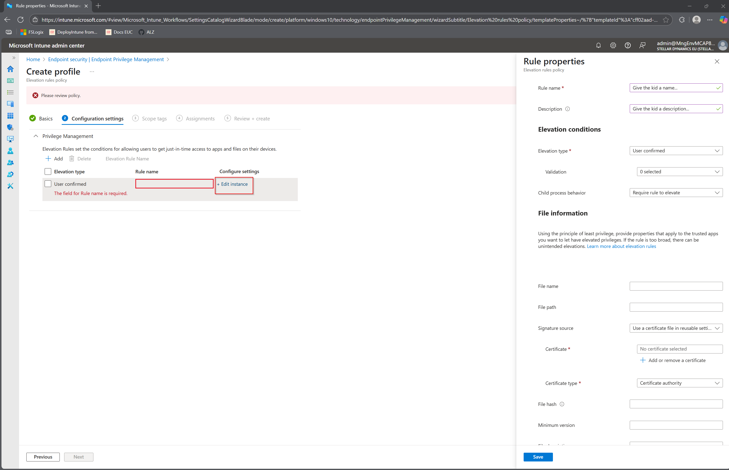

Slide 23
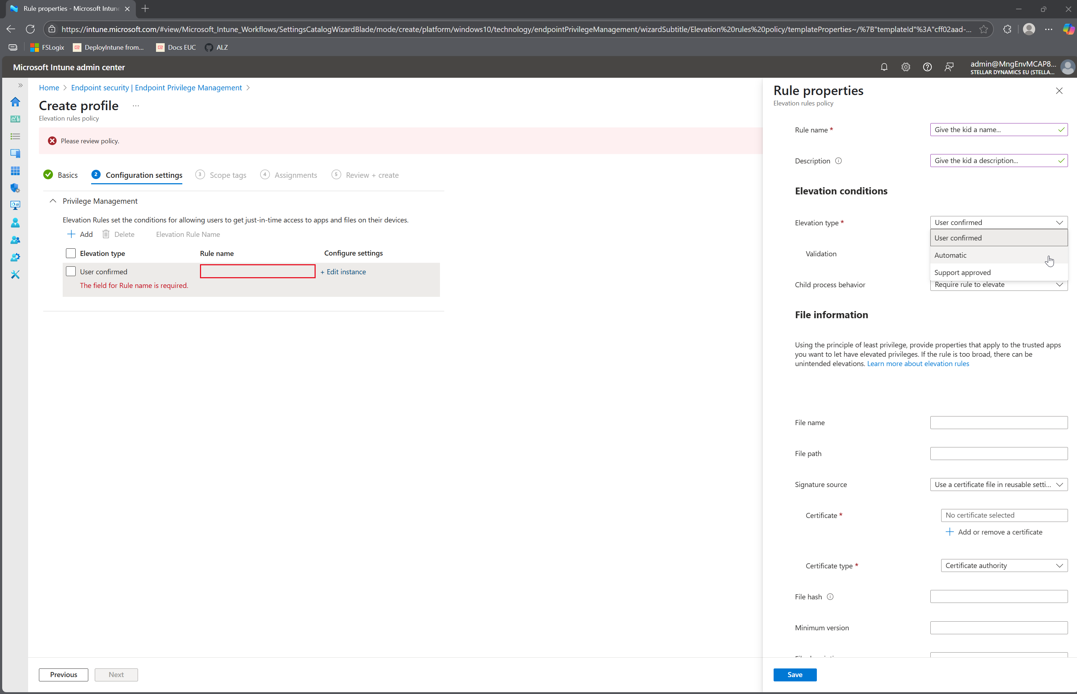

Slide 24
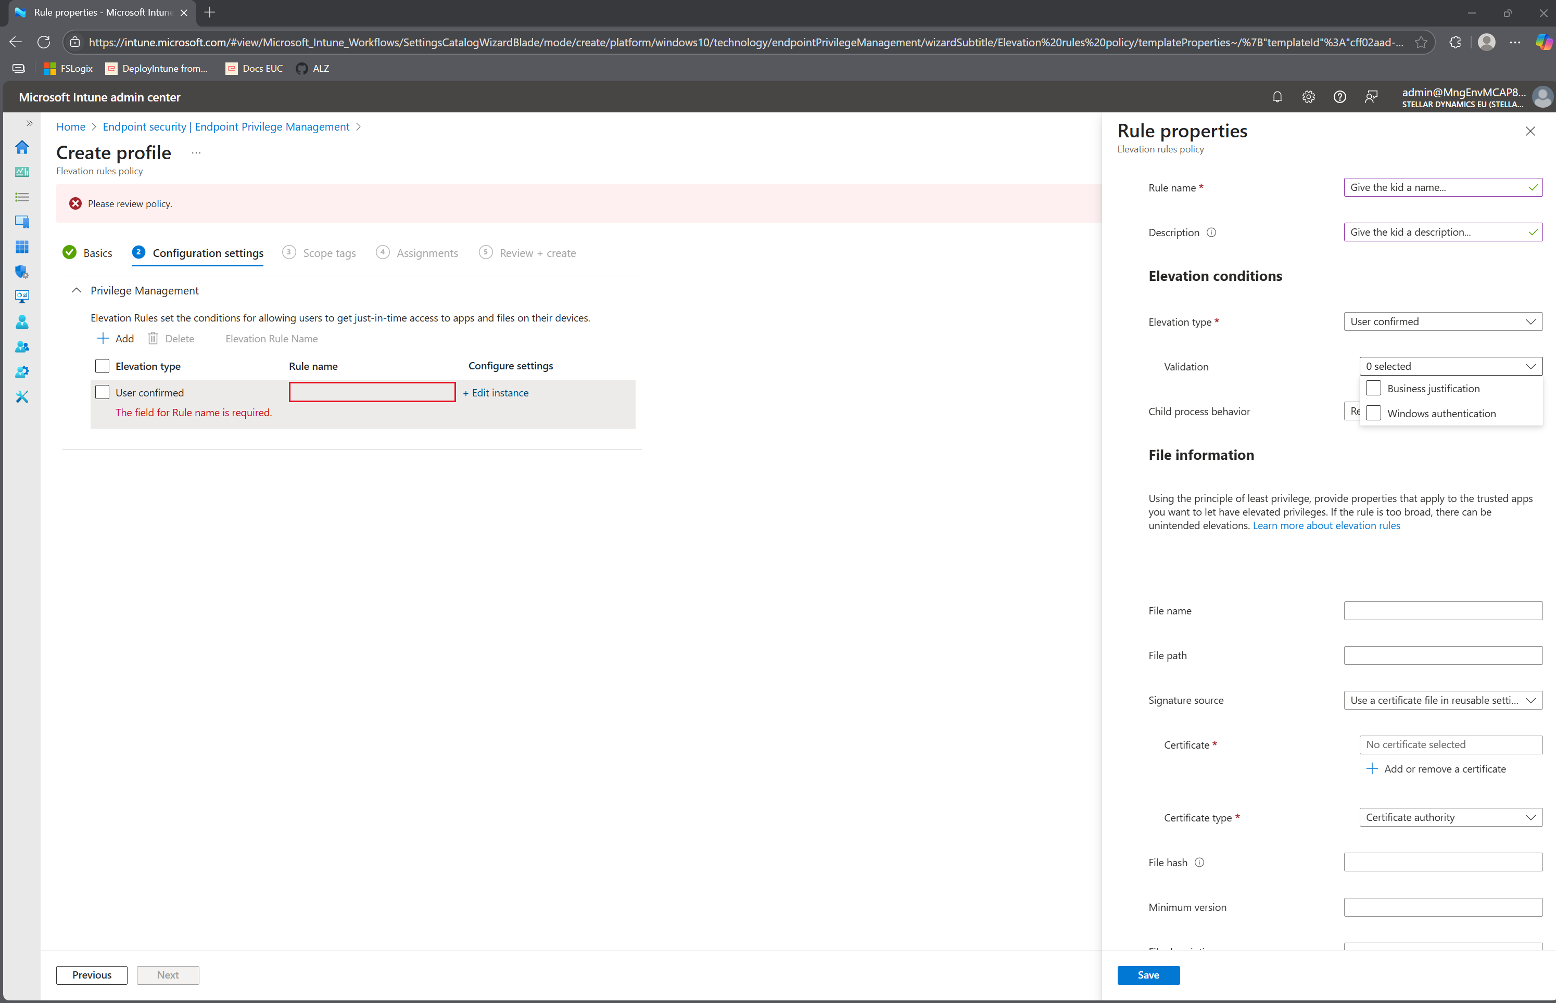

Slide 25
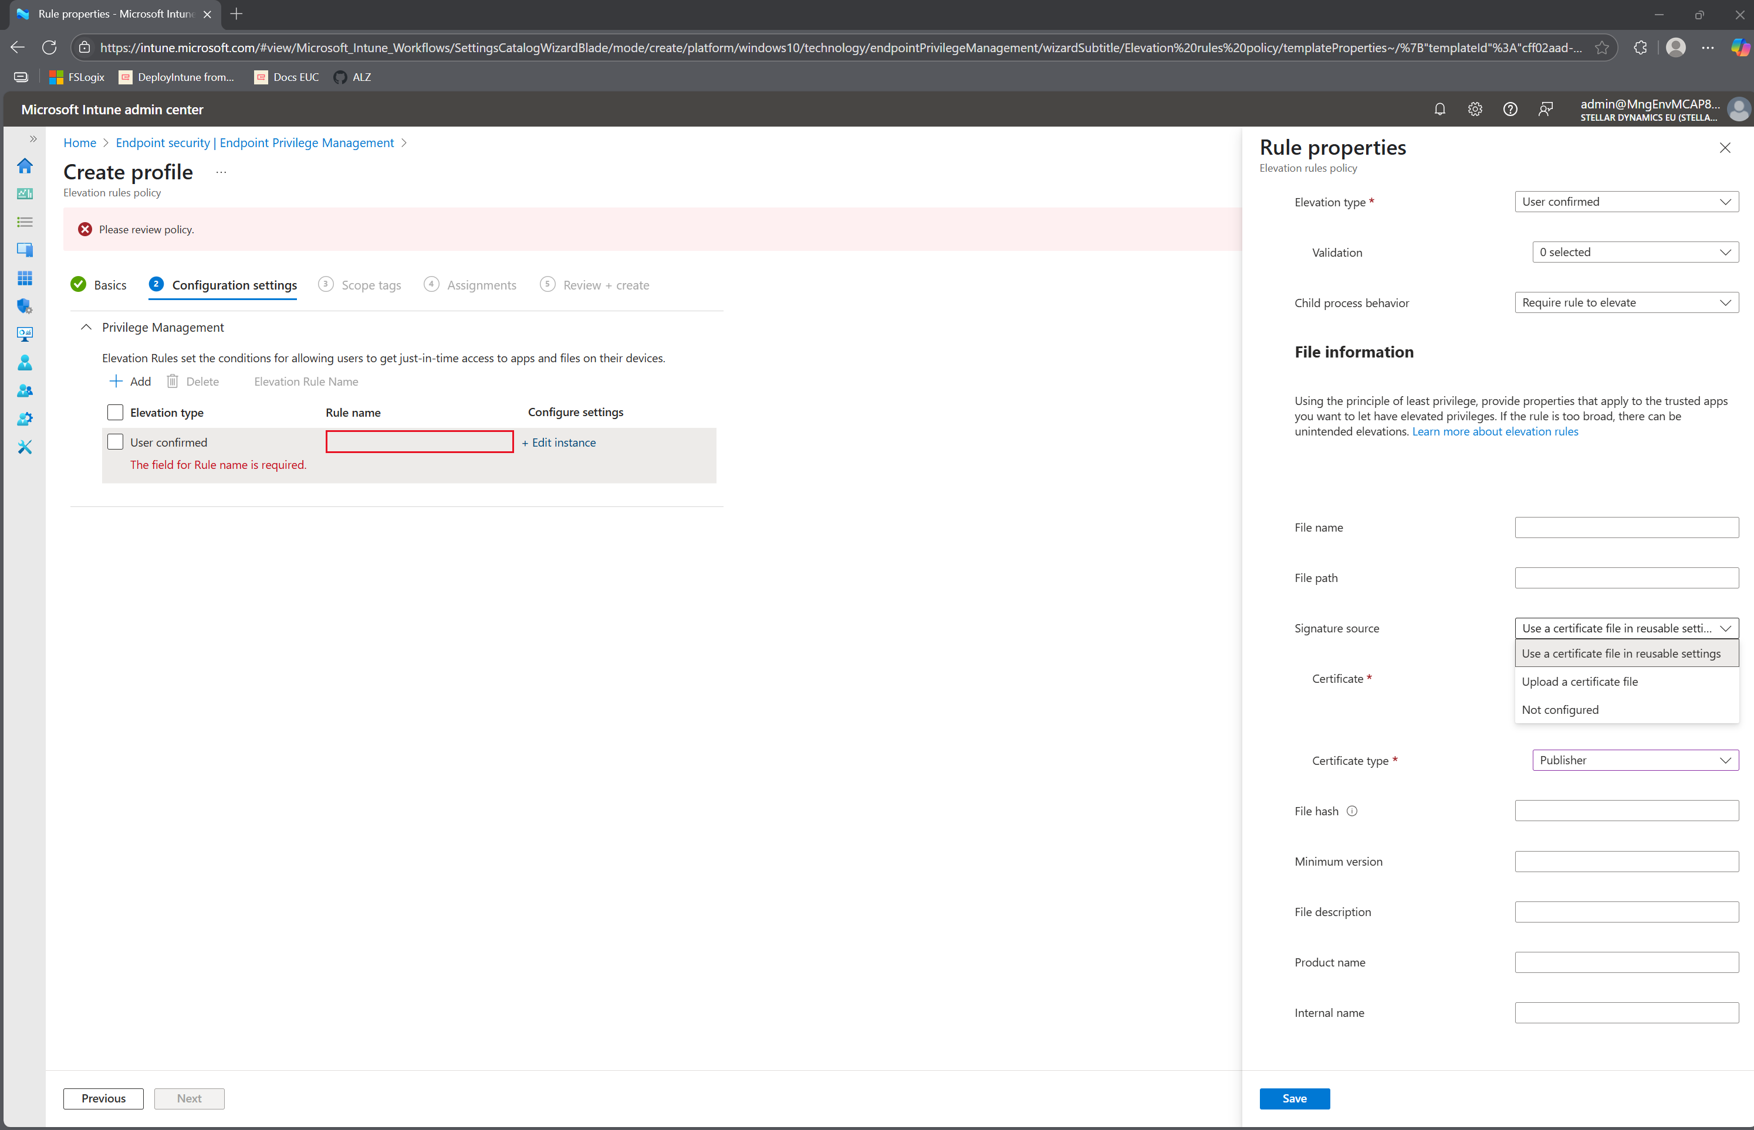

Slide 26
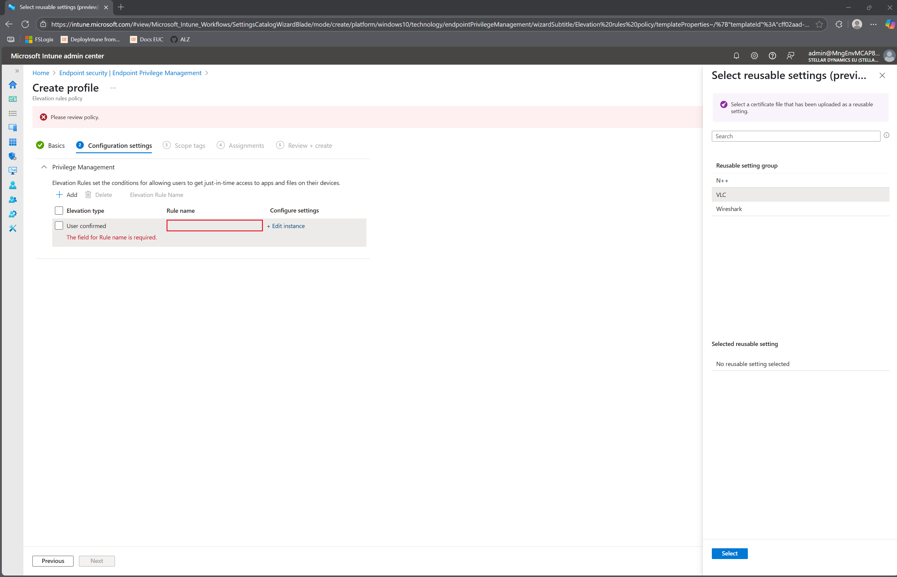

Slide 27
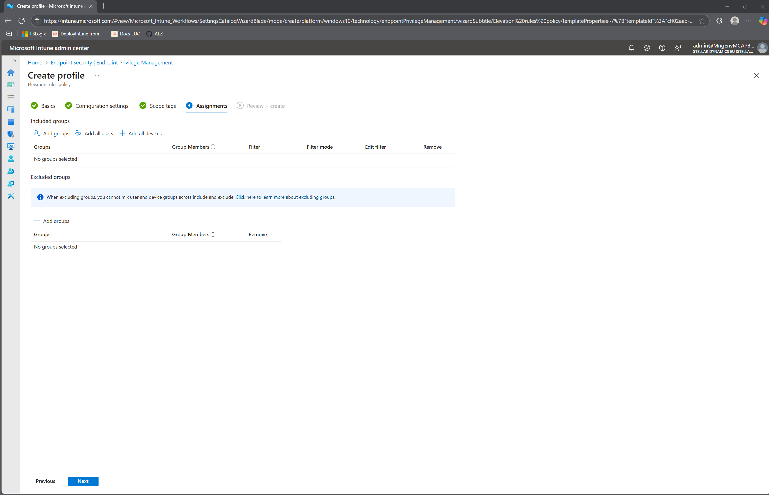

Slide 28
The end-user experience

Slide 29
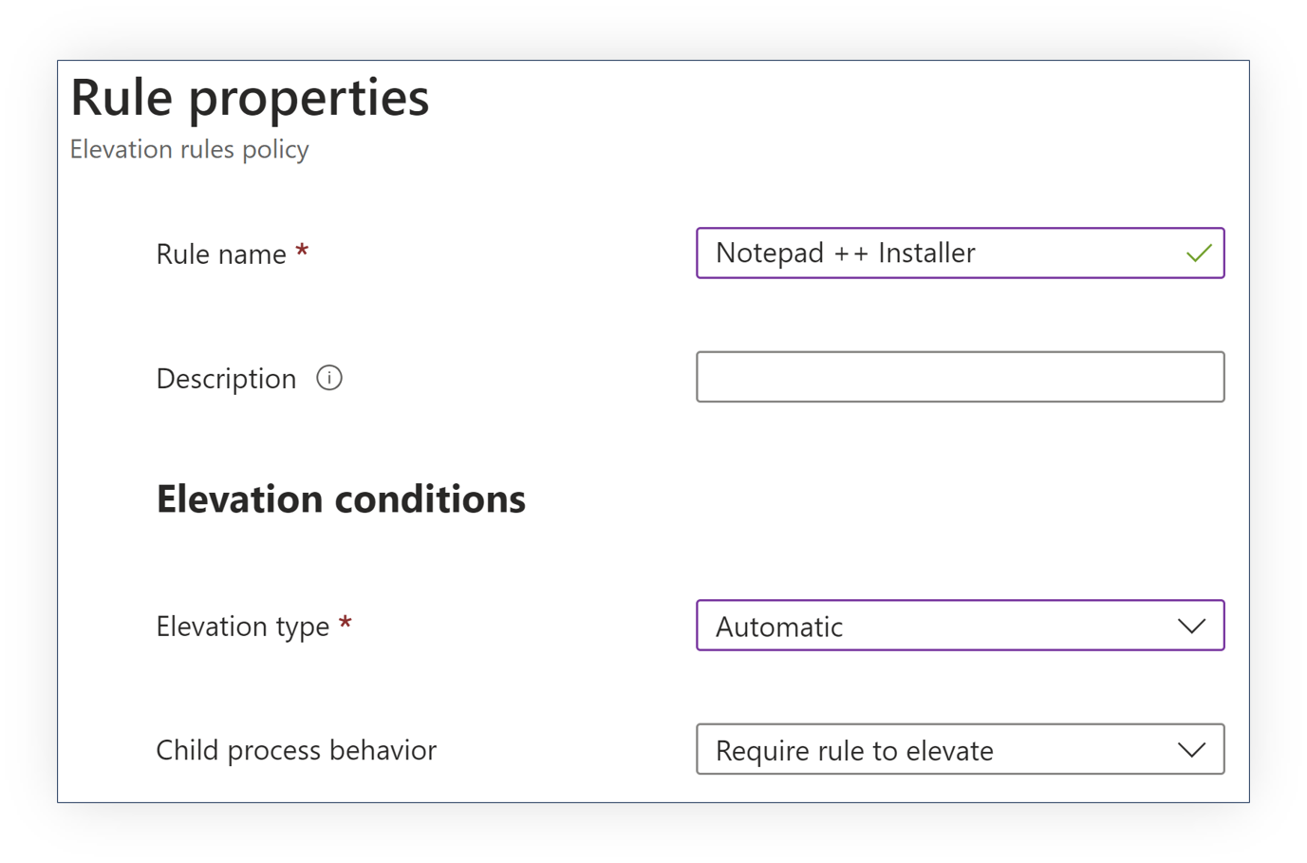
What types of Elevation Rules Policies are there?
Automatic Elevation
Provides an audit trail
Opaque to the end-user
Notes:
0,55 tussen 3 kolommen

Slide 31
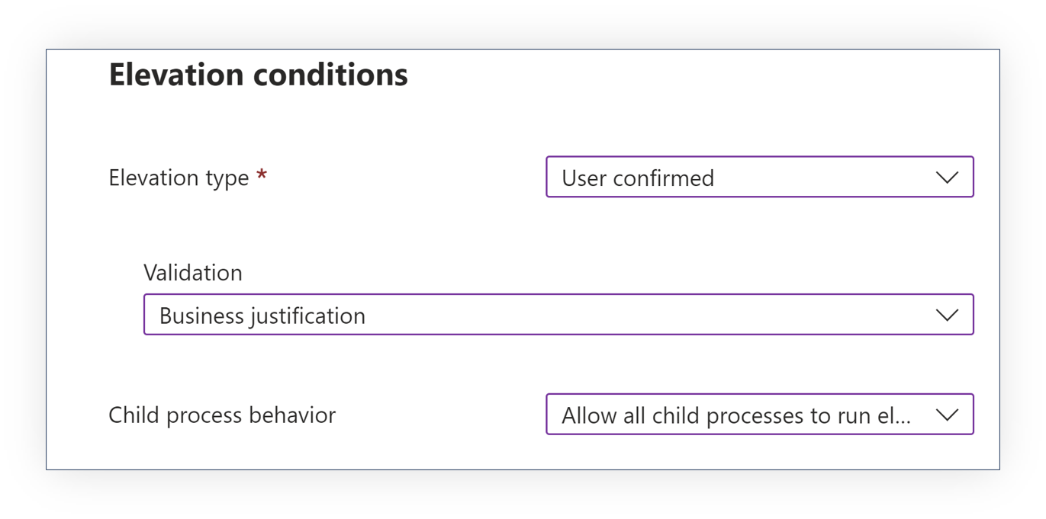
What types of Elevation Rules Policies are there?
User Confirmed Elevation
Provides an audit trail
Offers additional controls
Create a “guest list” of what can be elevated first
Confronts the user with a check
Notes:
0,55 tussen 3 kolommen

Slide 33
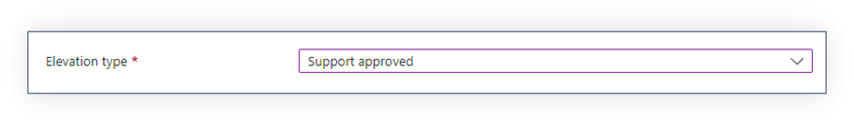
What types of Elevation Rules Policies are there?
Support Approved Elevation
Provides an audit trail
Allows you to add elevation to the “guest list”
Confronts the user with a check
Notes:
0,55 tussen 3 kolommen

Slide 35
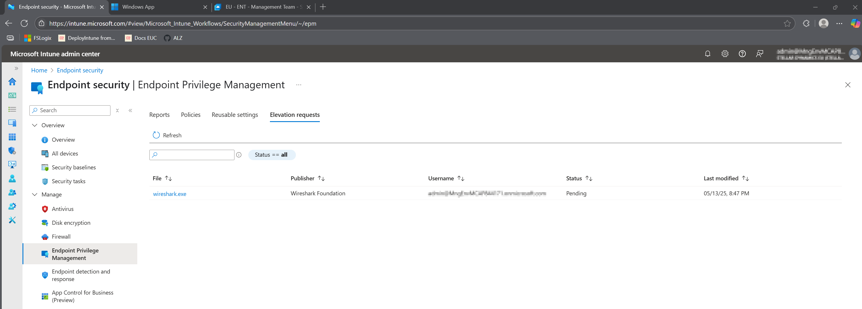
Managing the guest list – Elevation Requests

Slide 36
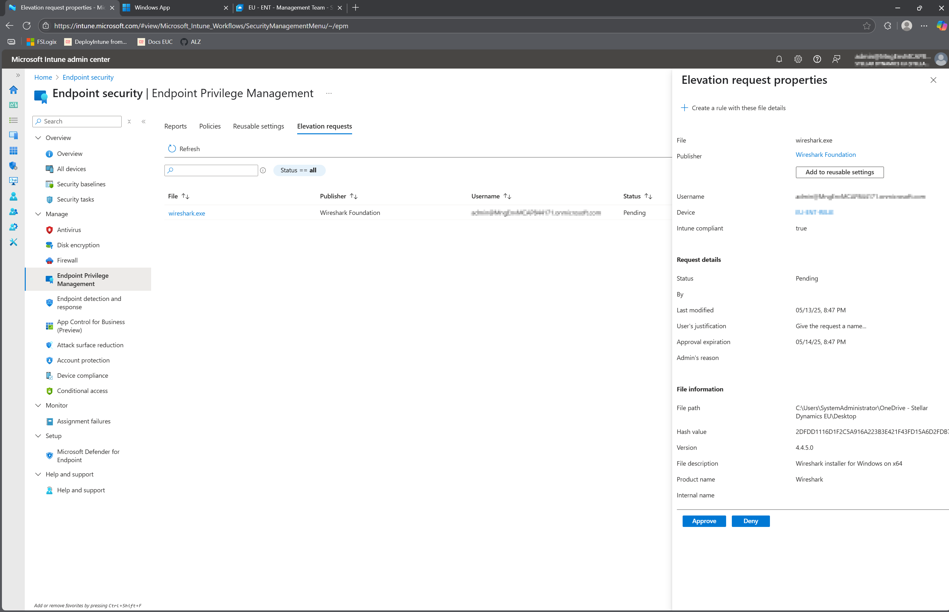

Slide 37
Getting started with EPM!
Get a license
Deploy an “elevation settings policy”
Deploy “elevation rules policy”
But wait! There’s more!
Reusable Settings & Reports
Notes:
Learn about using Endpoint Privilege Management with Microsoft Intune | Microsoft Learn

Slide 38
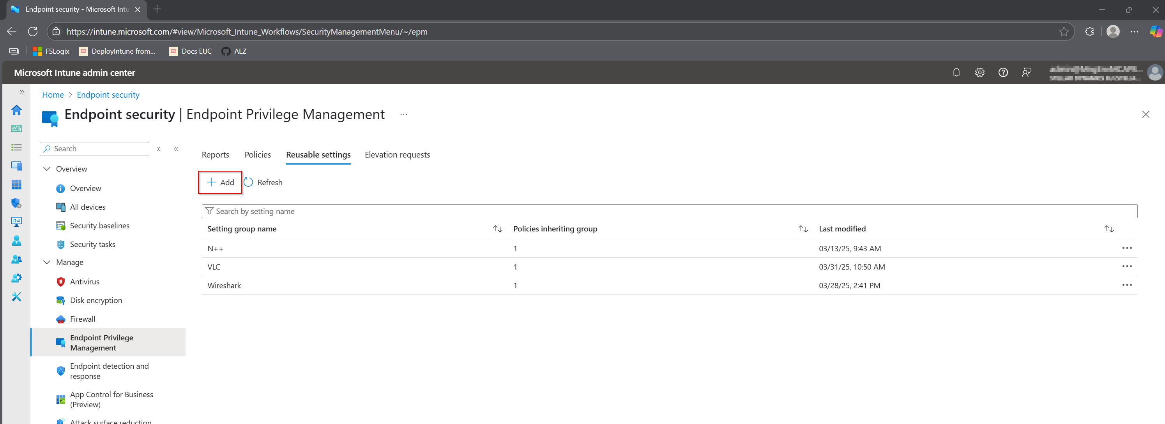
Keeping it manageable – Reusable Settings

Slide 39
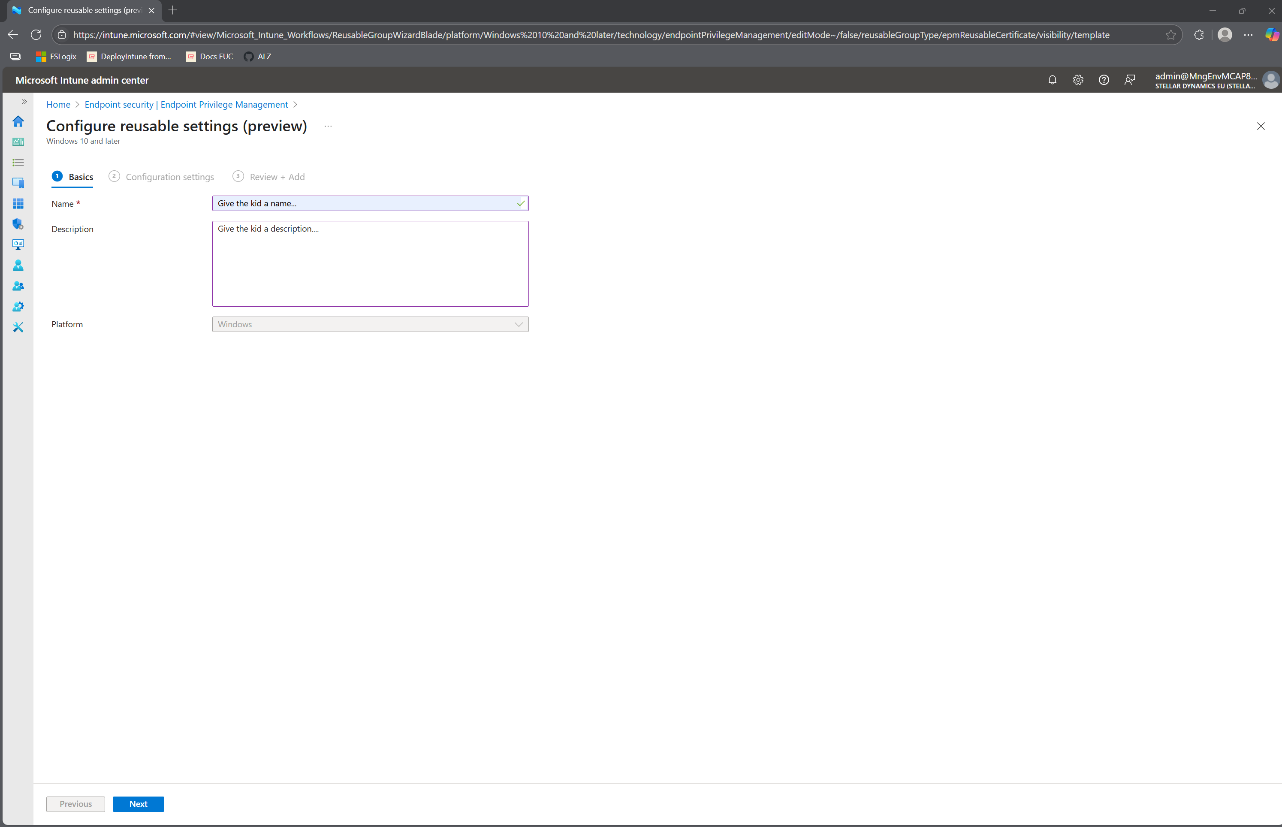

Slide 40
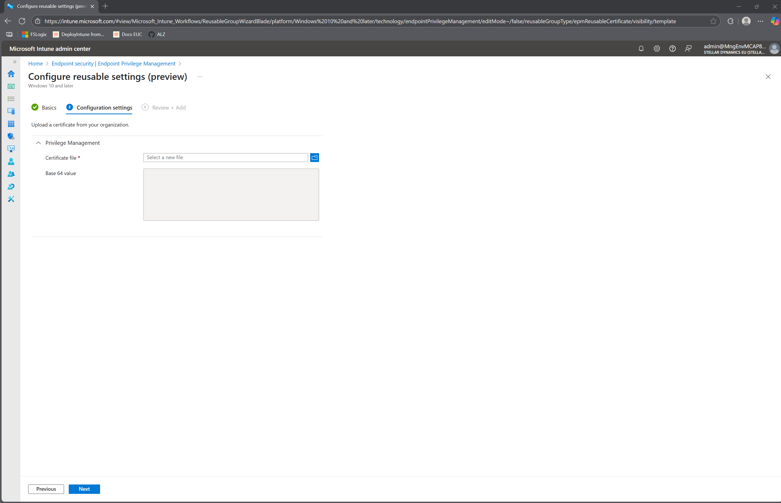
Notes:
Transfer to how to get these Certificate files -> EpmTools

Slide 41
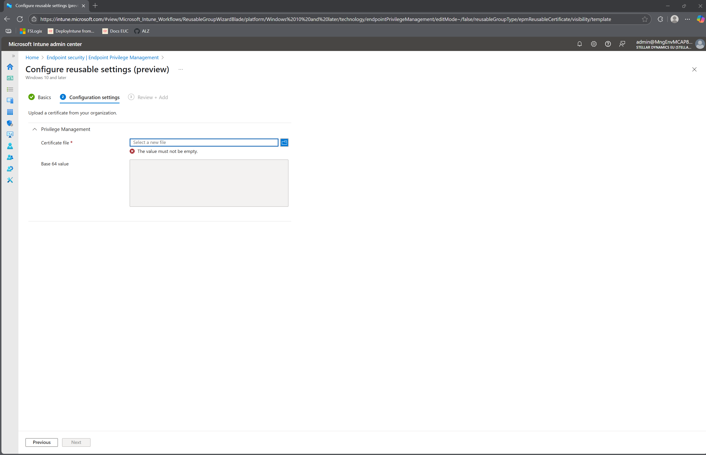

Slide 42
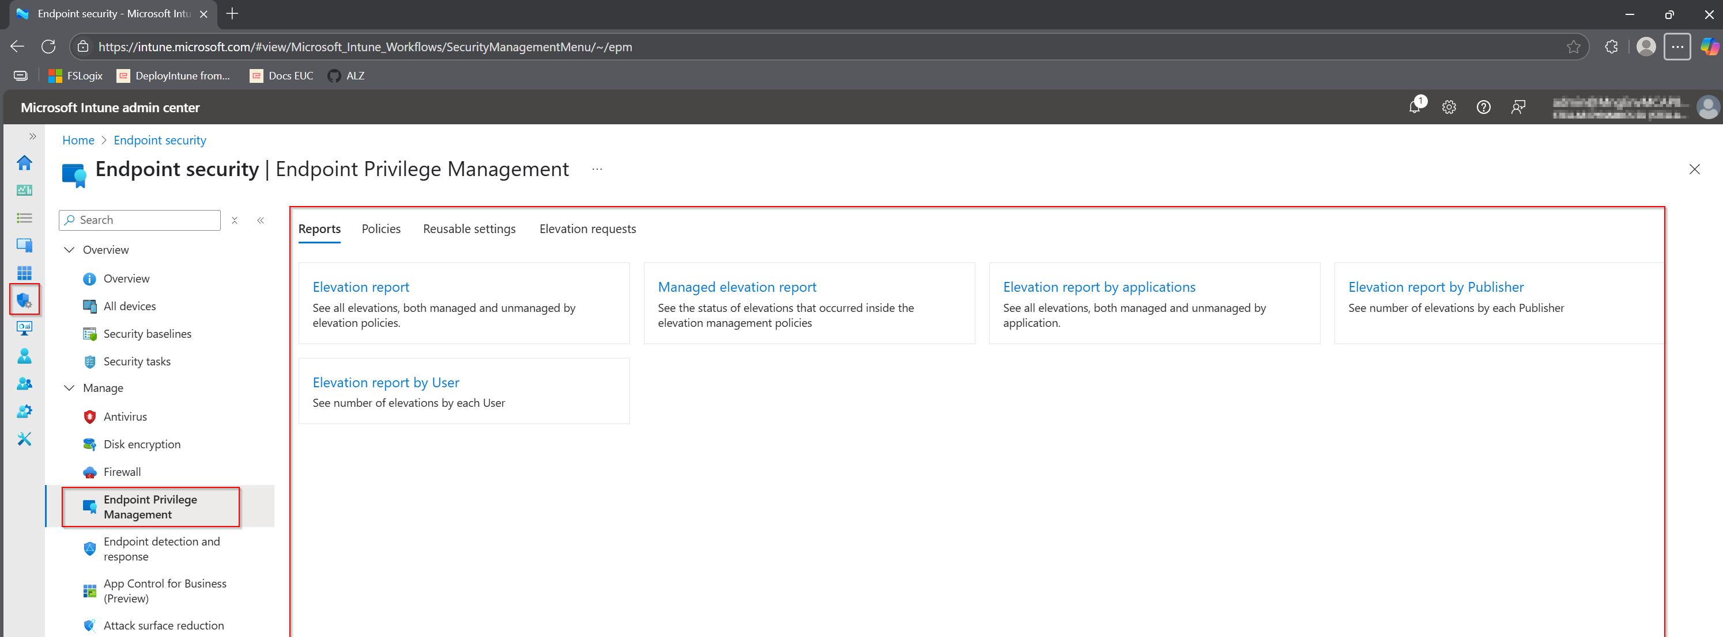
Don’t reinvent the wheel - Reports

Slide 43
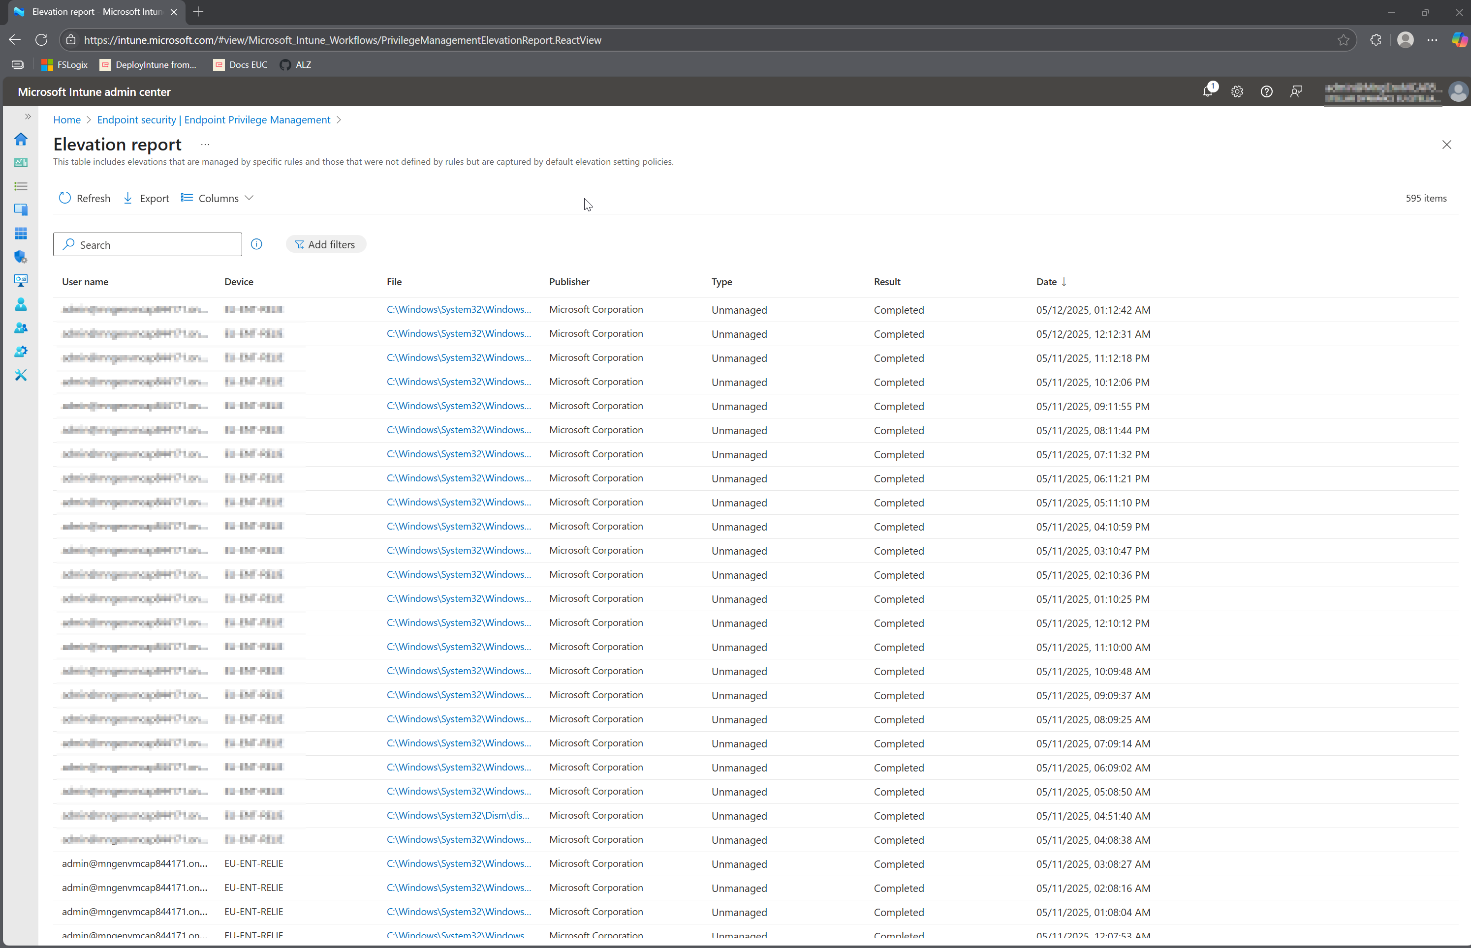

Slide 44
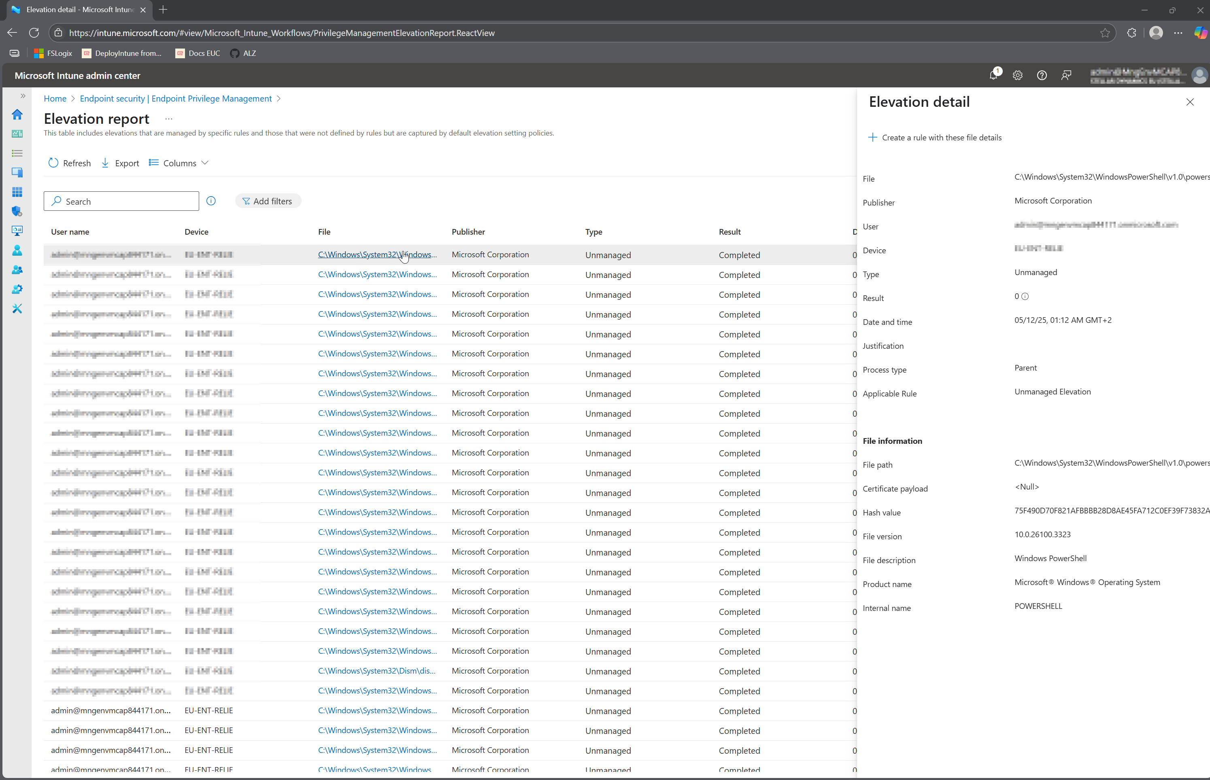

Slide 45
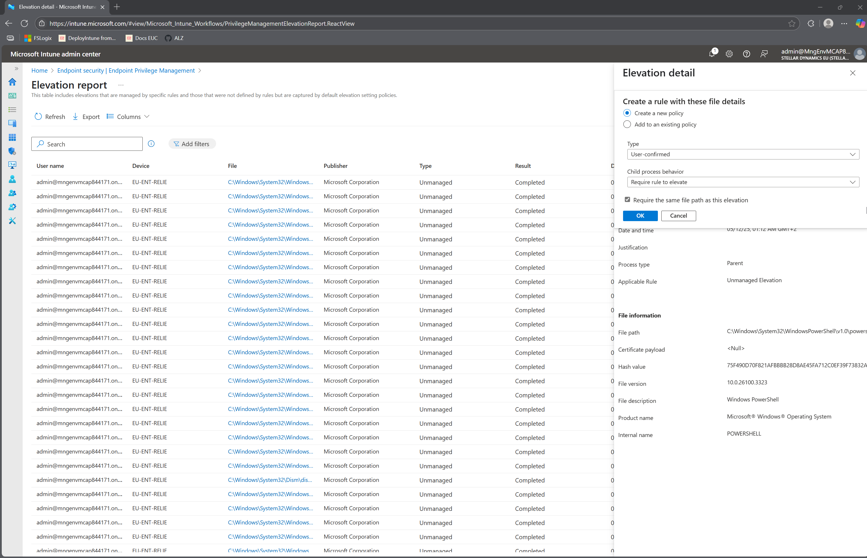

Slide 46
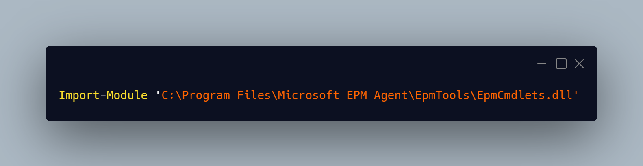
Harvesting Certificates – EpmTools PowerShell module
Notes:
Import-Module “C:\Program Files\Microsoft EPM Agent\EpmTools\EpmCmdlets.dll”

Slide 47
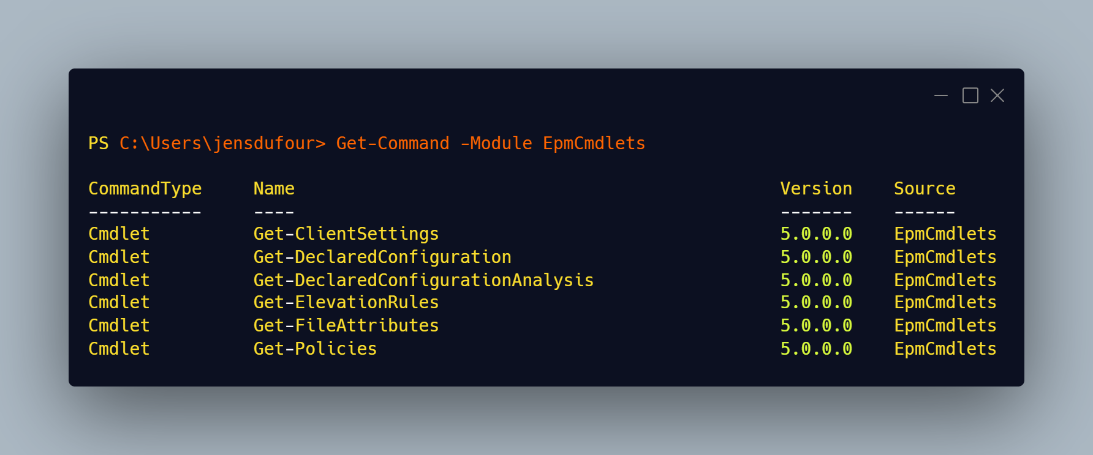
EpmTools PowerShell module
Notes:
Get-Command –Module EpmCmdlets
Get-DeclaredConfiguration -PolicyType
Get-FileAttributes –FilePath "C:\Users\SystemAdministrator\OneDrive - Stellar Dynamics EU\Desktop\wireshark.exe" –CertOutputPath ".\output"

Slide 48
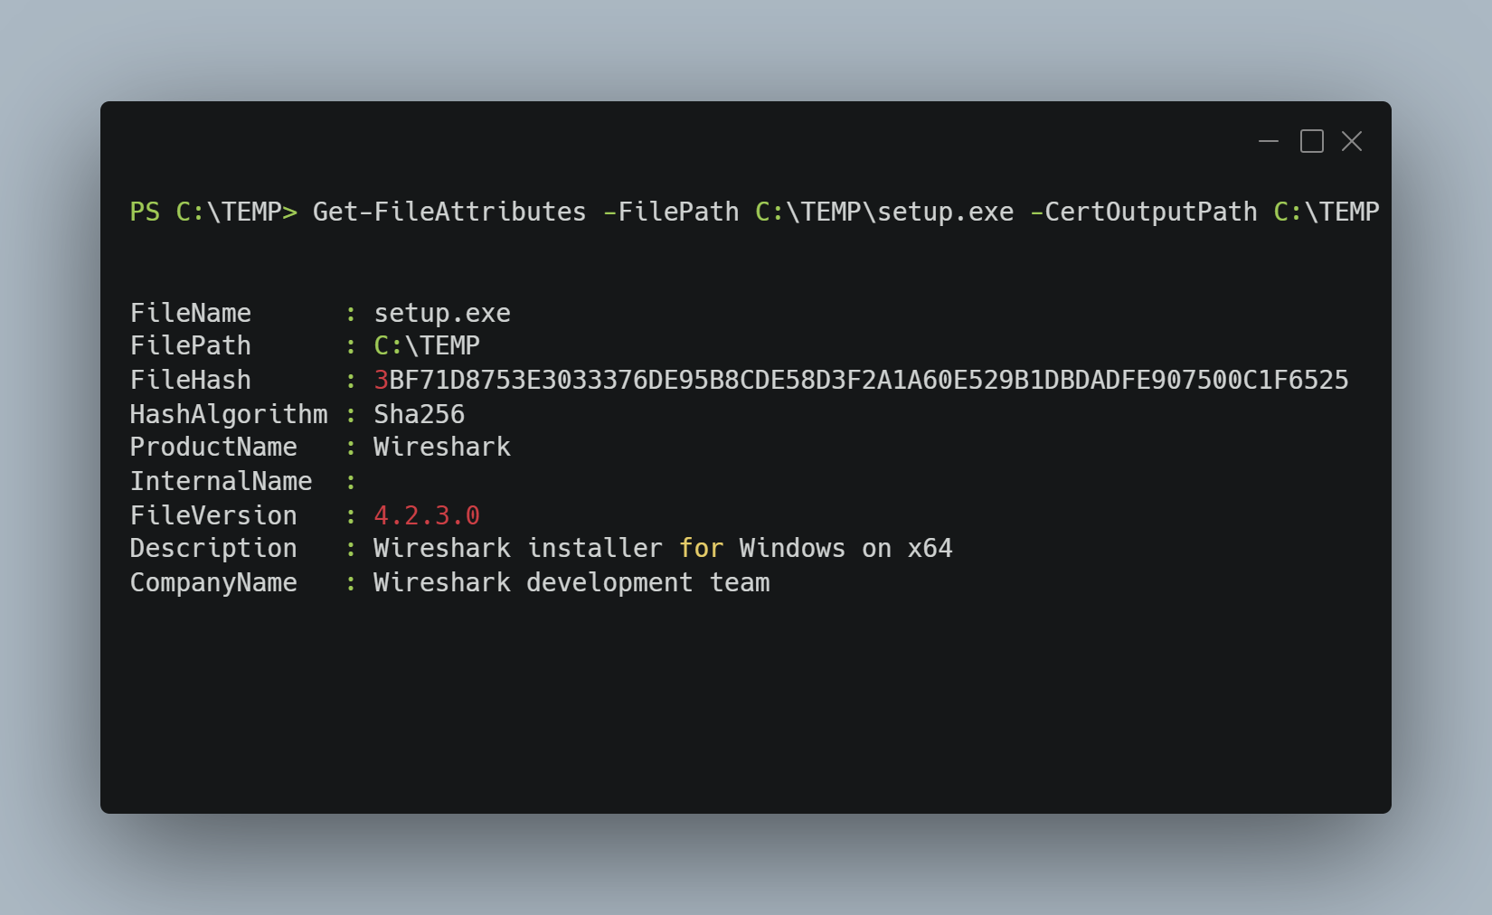

Slide 49
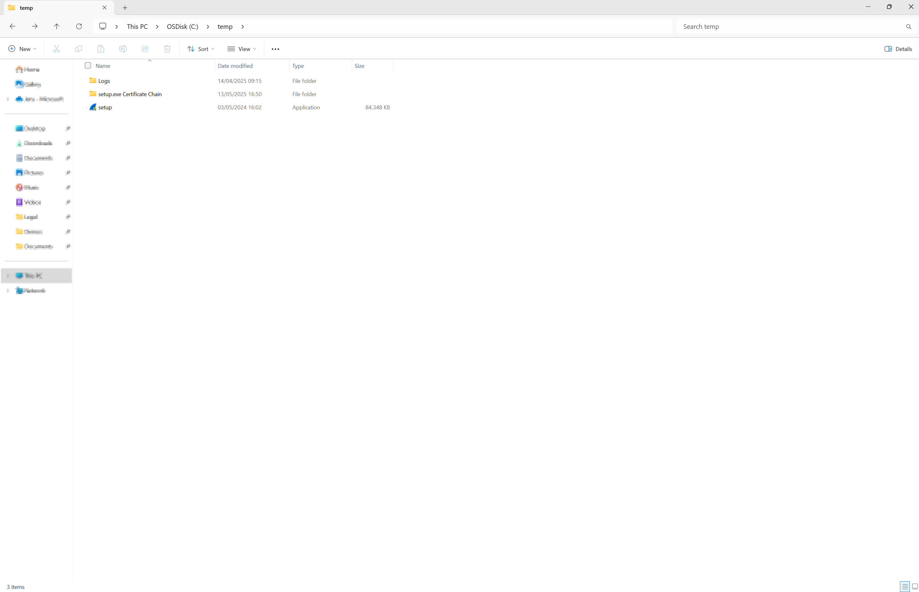

Slide 50
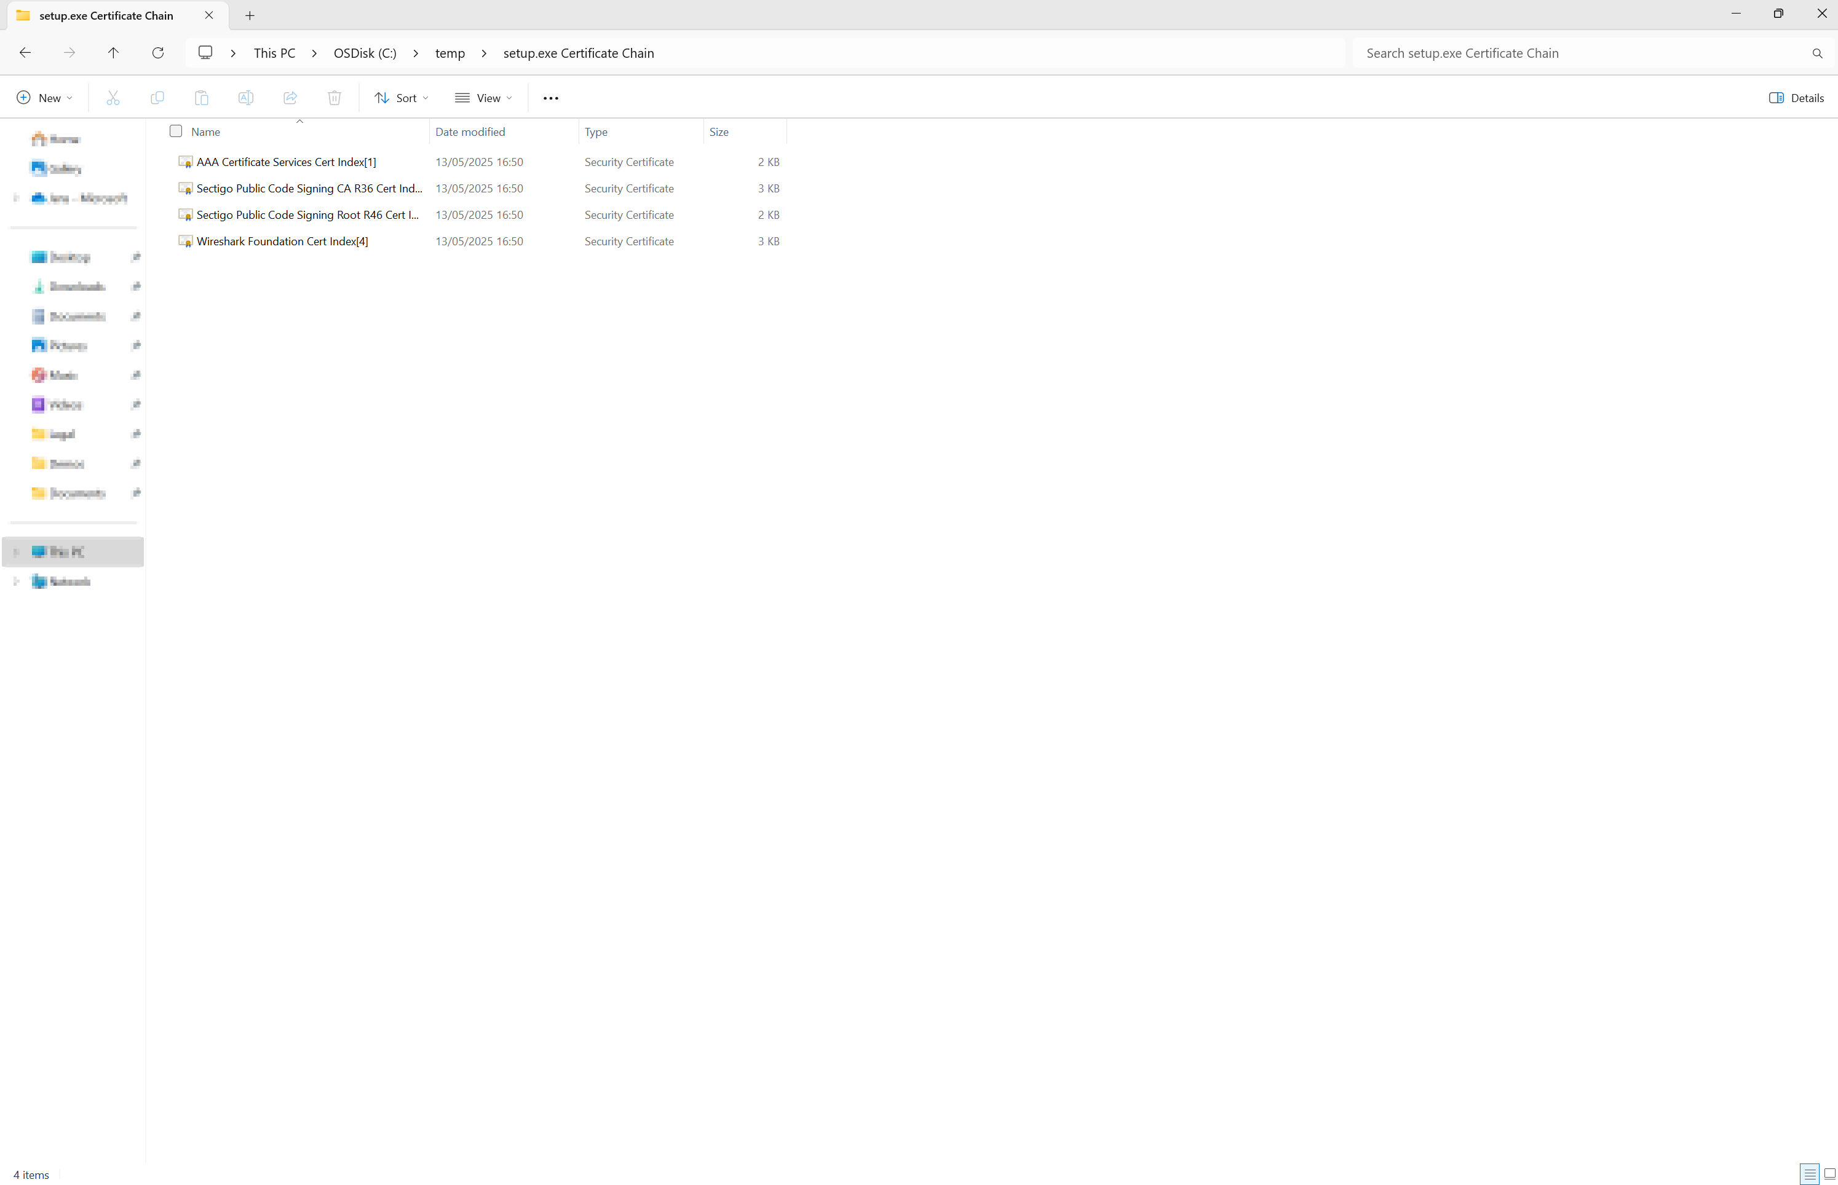

Slide 51
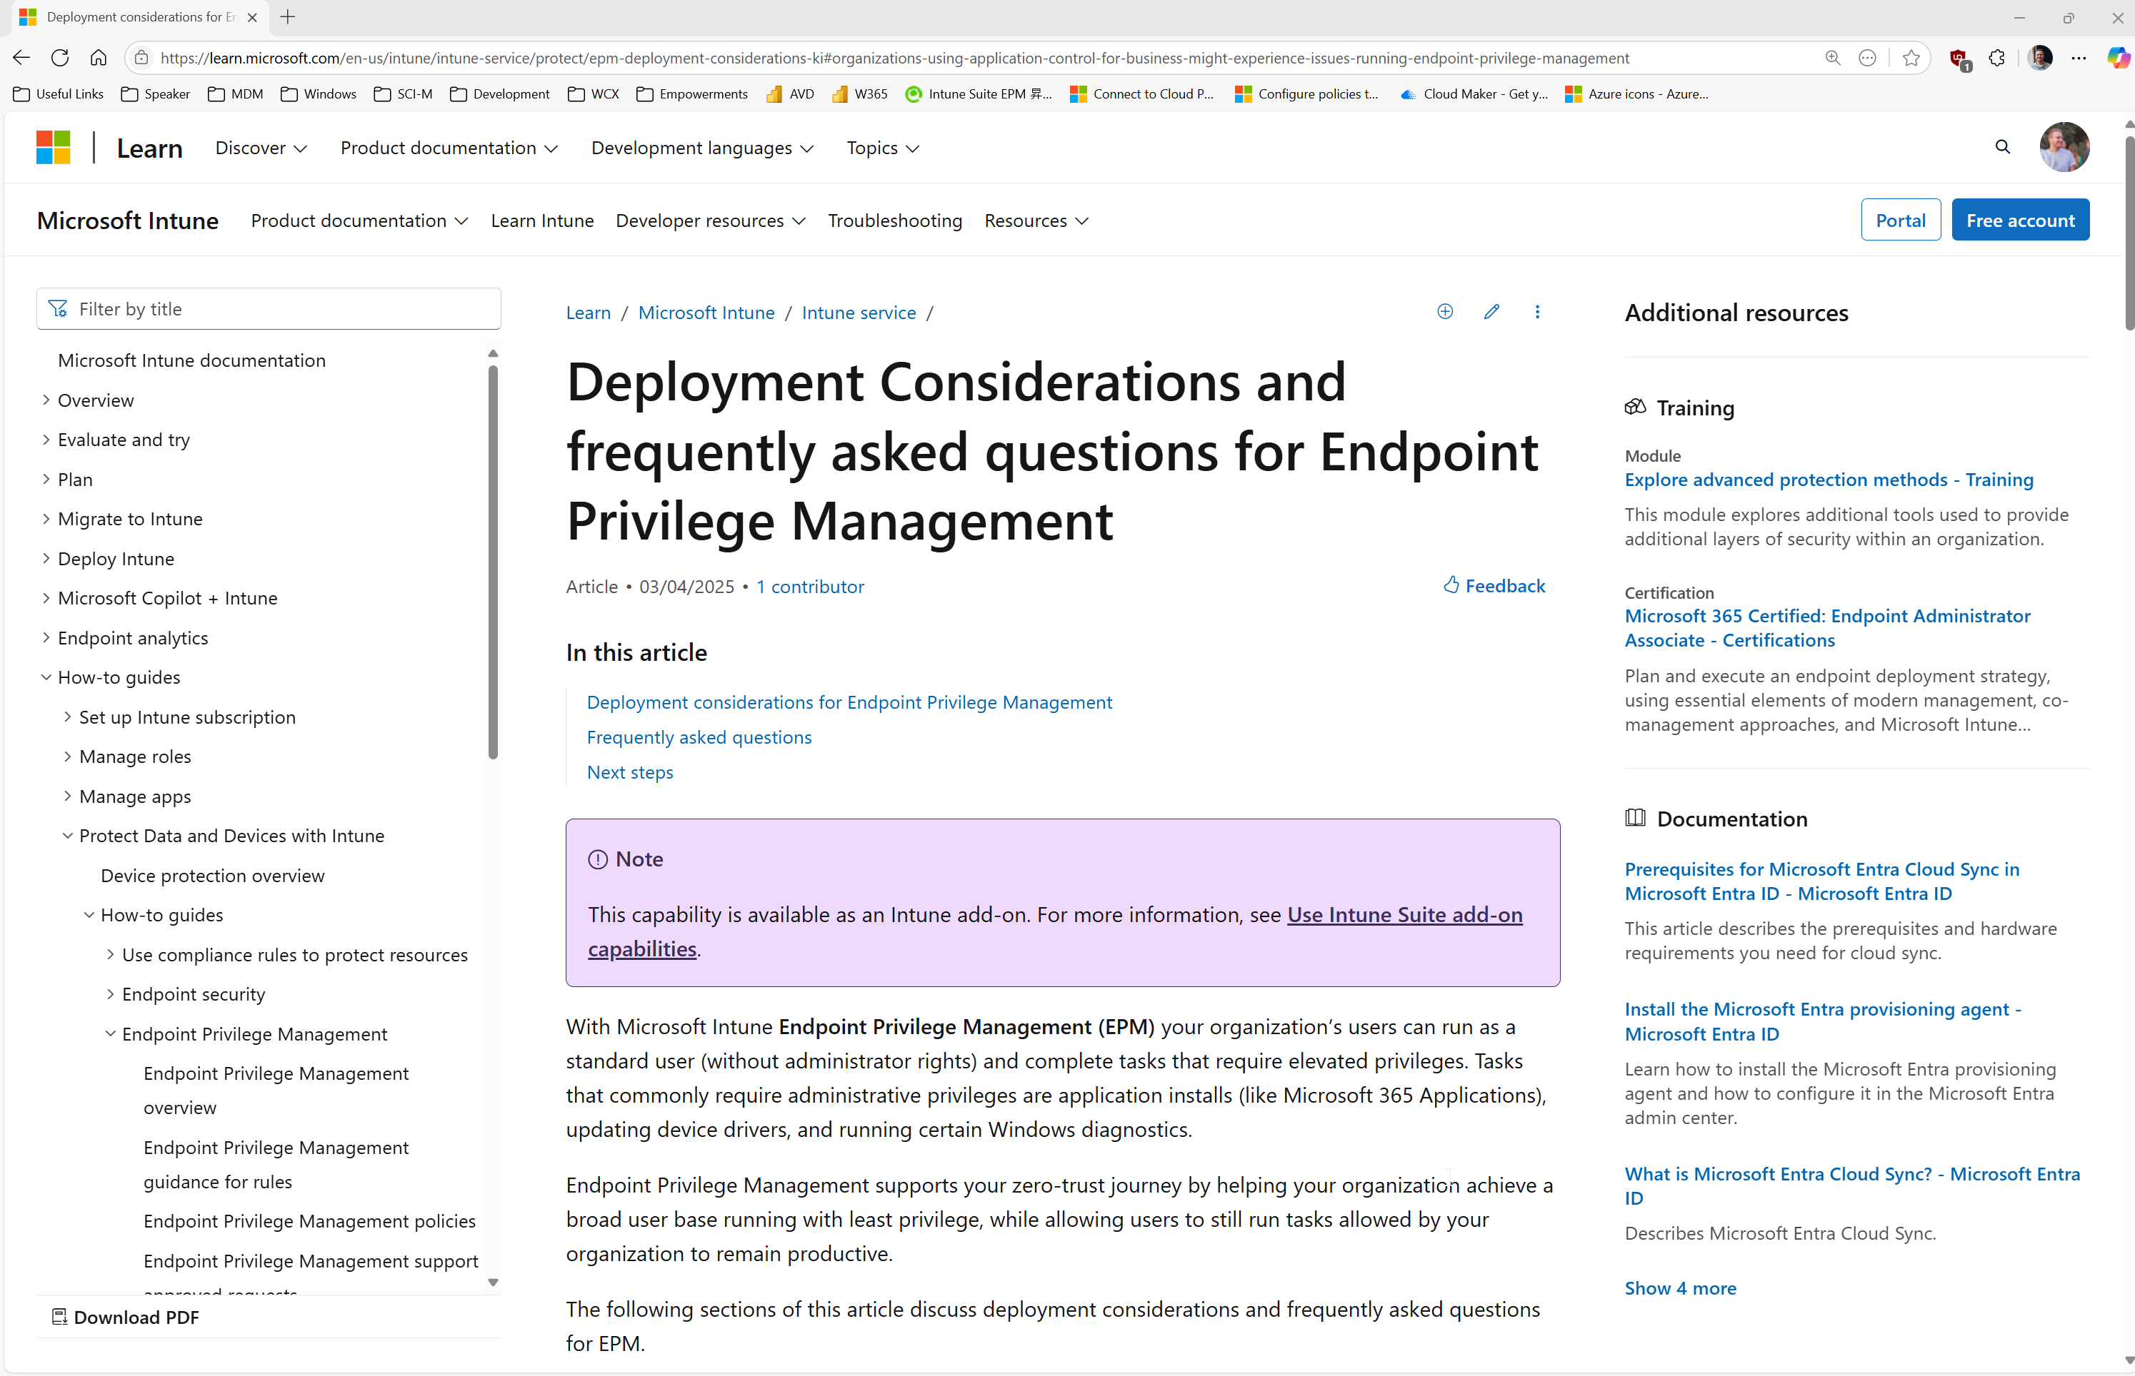
Deployment considerations for Endpoint Privilege Management
What can go wrong…
Notes:
Deployment considerations for Endpoint Privilege Management | Microsoft Learn

Slide 52
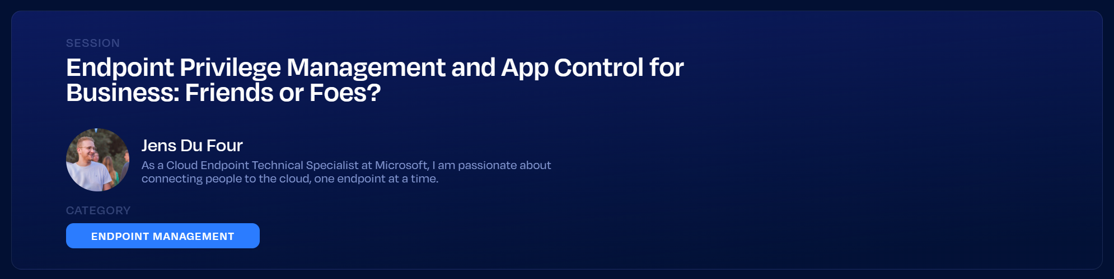
What can go wrong…

Slide 54
PLATINUM
GOLD
SILVER
SPONSORS
EVENT PARTNERS

